Slide 1
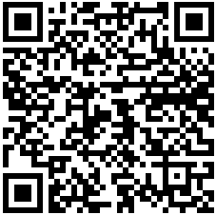
Rhetorical Strategies as Rhetorical Affordances: Antithesis and Paradox
Glen McClish
San Diego State University
gmcclish@sdsu.edu

Slide 2
“Riddle,” by Josephine Miles
You are a riddle I would not unravel,
You are the riddle my life comprehends.
And who abstracts the marvel
Abstracts the story to its sorriest ends.
But not your riddle. It is patient,
Never more than it says, and since that is
Impossible, it is the marvel
Nobody, as I am nobody, believes.

Slide 3
My purpose is to help you:
1. Perceive of rhetorical strategies not as belletristic displays intended to impress or gratify or elements to check off in an assignment rubric but as essential tools for persuasion that often define arguments.
2. Identify the rhetorical affordances (pedagogical potential or opportunities) of the texts you teach.
3. Reimagine the power of rhetorical strategies such as antithesis and paradox within the ERWC reading-to-writing arc, including reading with and against the grain and composing preliminary and culminating assignments.

Slide 4
Principle of Text Selection: I have deliberately featured texts from rhetors from groups historically oppressed and disregarded.

Slide 5
Arguments Based on Antithesis
Many rhetors rely on either/or dichotomies built on the rhetorical strategy of antithesis. Antithesis, according to Jeanne Fahnestock, is “created when two parallel phrases or clauses feature words that an audience would recognize as opposites. . . . Antithesis often appears in arguments when the rhetor wants to draw stark contrasts” (232–33).
Identifying antitheses, whether intended to construct subtle distinctions or simplistic, exaggerated differences or false dilemmas, is a highly transferable rhetorical skill that strengthens with- and against-the-grain reading and composition.

Slide 6
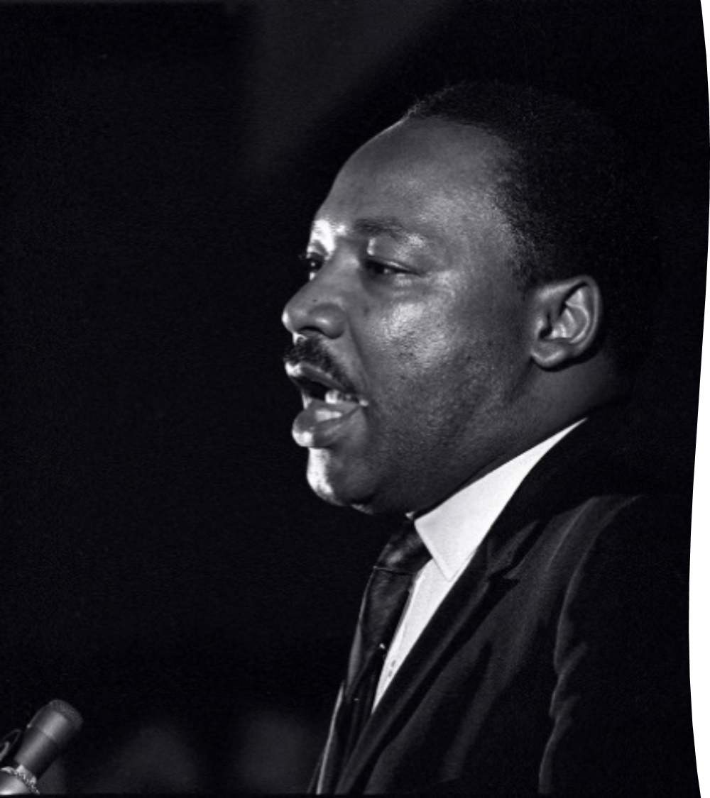
Martin Luther King’s Antithesis in
“I’ve Been to the Mountaintop” as Mentor Text
In some cases, a rhetor may attempt to replace one
antithesis with another, reframing an either/or situation
to recast the argument. This move, when executed
deftly, can disarm oppositional arguments.
On April 3, 1968, the evening before he was assassinated, Martin Luther King Jr. addressed a roomful of supporters of striking sanitation workers in Memphis, Tennessee:

Slide 7
I’ve Been to the Mountaintop
Men, for years now, have been talking about war and peace. But now, no longer can they just talk about it. It is no longer a choice between violence and nonviolence in this world; it’s nonviolence or nonexistence. That is where we are today (209).

Slide 8
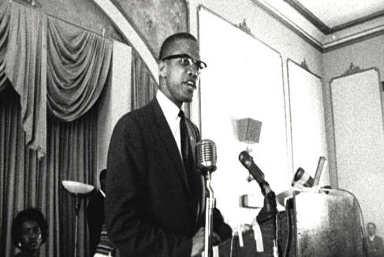
Malcolm X’s Antithesis in
“The Ballot or the Bullet” as Mentor Text
On April 12, 1964, Malcolm X delivered
what some consider the definitive version
of his speech “The Ballot or the Bullet” at
King Solomon Baptist Church in Detroit to
an audience of 2,000 people.

Slide 9
The Ballot or the Bullet
Questions for Discussion
1. How does antithesis seem to work as a primary rhetorical strategy in the selection from “The Ballot or the Bullet” provided?
2. What does reading Malcolm X’s antitheses with and against the grain reveal about his argument?
3. How does Malcolm X’s ethos relate to his use of antithesis?
4. What antithesis does Malcolm X seem to be supplanting?

Slide 10
Completing the Arc: Composing with Antithesis
1. What kinds of culminating composing assignments could feature antithesis is the central rhetorical strategy?
2. What are the particular affordances of antitheses that emphasize either/or differences, including those that reframe other antitheses?
3. How does the strategy of antithesis affect the ethos of the rhetor? What are the consequences of this?

Slide 11
Arguments Based on Paradox
In contrast with antithesis, the strategy of paradox brings together apparent oppositions and resolves contradictions. Here is Fahnestock’s definition of paradox: “On its face the paradoxical proposition is deliberately self-contradicting. . . . The speaker maintains a contradiction, knowing that the audience will perceive it as such, and then goes on to solve it” (118). There is an artful, even mystical quality about paradoxes that when employed kairotically conveys a unique rhetorical power. Like antithesis, paradox is a transferable skill for analysis and invention.

Slide 12
King’s Paradox in “I’ve Been to the Mountaintop” as Mentor Text
King emphasized that despite the formidable challenges African Americans faced in 1968, if the audience exercised agency in support of the Memphis sanitation workers they could further the goals of the Civil Rights movement.

Slide 13
I’ve Been to the Mountaintop
Something is happening in Memphis; something is happening in our world. And you know, if I were standing at the beginning of time, with the possibility of taking a kind of general and panoramic view of the whole of human history up to now, and the Almighty said to me, “Martin Luther King, which age would you like to live in?” Strangely enough, I would turn to the Almighty, and say, “If you allow me to live just a few years in the second half of the 20th century, I will be happy.” Now that’s a strange statement to make, because the world is all messed up. The nation is sick. Trouble is in the land; confusion all around. That’s a strange statement. But I know, somehow, that only when it is dark enough can you see the stars. And I see God working in this period of the twentieth century in a way that men, in some strange way, are responding [to]—something is happening in our world (207–09).

Slide 14
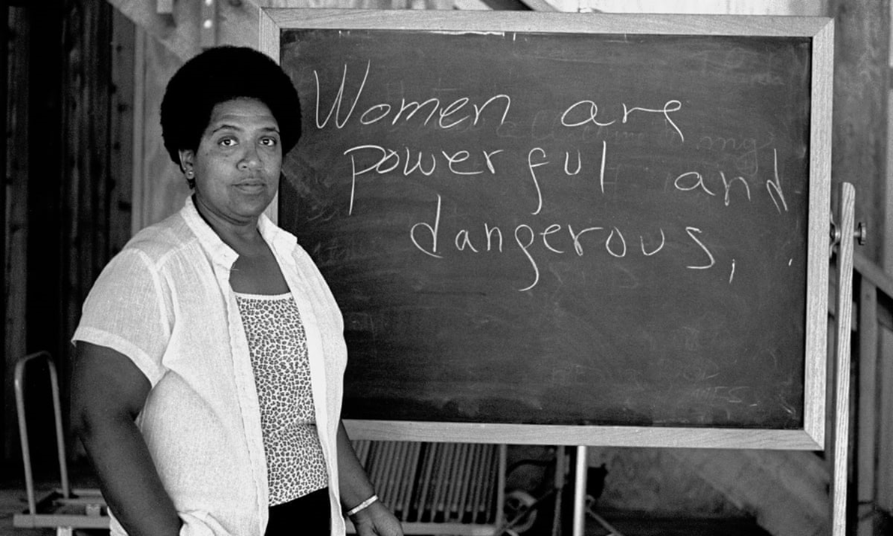
Lorde’s Paradoxes in “The Transformation of Silence into Language and Action” as Mentor Text
A key rhetorical affordance of Audre Lorde’s paper “The Transformation of Silence into Language and Action” (delivered on December 28, 1977, at the Modern Language Association’s “Lesbian and Literature Panel” in Chicago) is the strategy of paradox.

Slide 16
“The Transformation of Silence into Language and Action”
Questions for Discussion
1. How does paradox seem to work as a primary rhetorical strategy in the selection from “The Transformation of Silence into Language and Action”? What seeming realities does Lorde encourage the audience to reimagine?
2. What do readings with and against the grain reveal about Lorde’s argument?
3. How does Lorde’s ethos relate to the strategy of paradox?

Slide 17
Malcolm X, “The Ballot or the Bullet,” Revisited
Unification through common characteristics or ground, rather than paradox:
So today, though Islam is my religious philosophy, my political, economic and social philosophy is black nationalism. You and I —[applause] As I say, if we bring up religion, we’ll have differences, we’ll have arguments, and we’ll never be able to get together. But if we keep our religion at home, keep our religion in the closet, keep our religion between ourselves and our God, but when we come out here we have a fight that’s common to all of us against an enemy who is common to all of us. [applause]

Slide 18
Completing the Arc: Composing with Paradox
1. What kind of arguments could students compose in which paradox functions as their central rhetorical strategy?
2. What are the particular affordances of paradox?
3. How does the strategy of paradox affect a rhetor’s ethos?
4. What strategies besides paradox function to collapse or challenge binaries?

Slide 19
Works Cited
Fahnestock, Jeanie. Rhetorical Style: The Uses of Language in Persuasion. Oxford, 2011.
King, Martin Luther. “I’ve Been to the Mountaintop.” A Call to Conscience: The Landmark Speeches of Dr Martin Luther King Jr., edited by Clayborne Carson and Kors Shepard, Warner Books, 2001, 207–23.
Lorde, Audre. “The Transformation of Silence into Language and Action.” Sister Outsider, The Crossing P, 1984, 40–44.
Malcolm X. “The Ballot or the Bullet.” Say It Loud: Great Speeches on Civil Rights and African American Identity, edited by Catherine Ellis and Stephen Smith, The New P, 2020, 1–18.

Slide 20
Supplementary Texts
Donne, John. “Batter my heart, three-person’d God.” Poetry Foundation. An arresting example of paradox.
Miles, Josephine. “Riddle.” Collected Poems: 1930-83, U of Illinois P, 1983, 107. An irresistible example of paradox.

