Slide 1
Using Virtual Museum Spaces to Engage Multiple Literacies in the ERWC Classroom
2025 ERWC Literacy Conference
Dr. Seth Spencer

Slide 2
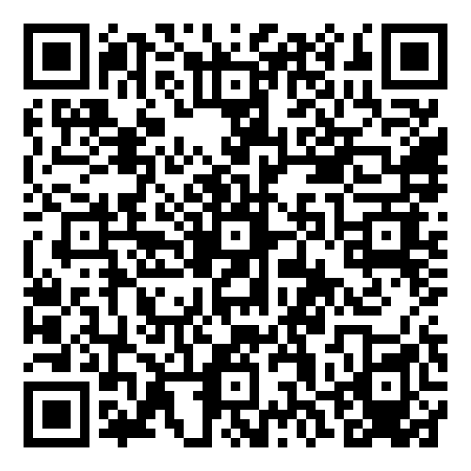
~https://www.artsteps.com/
~Click "sign up"

Slide 3
Artsteps:
~Treats reading and writing as social practices (Katz, et al. 2)
~Broadens notions of reading, composing, and literacy (Katz, et al. 3)
~Embodies a culturally sustaining pedagogy (Alim and Paris 1; McLean 17)

Slide 4
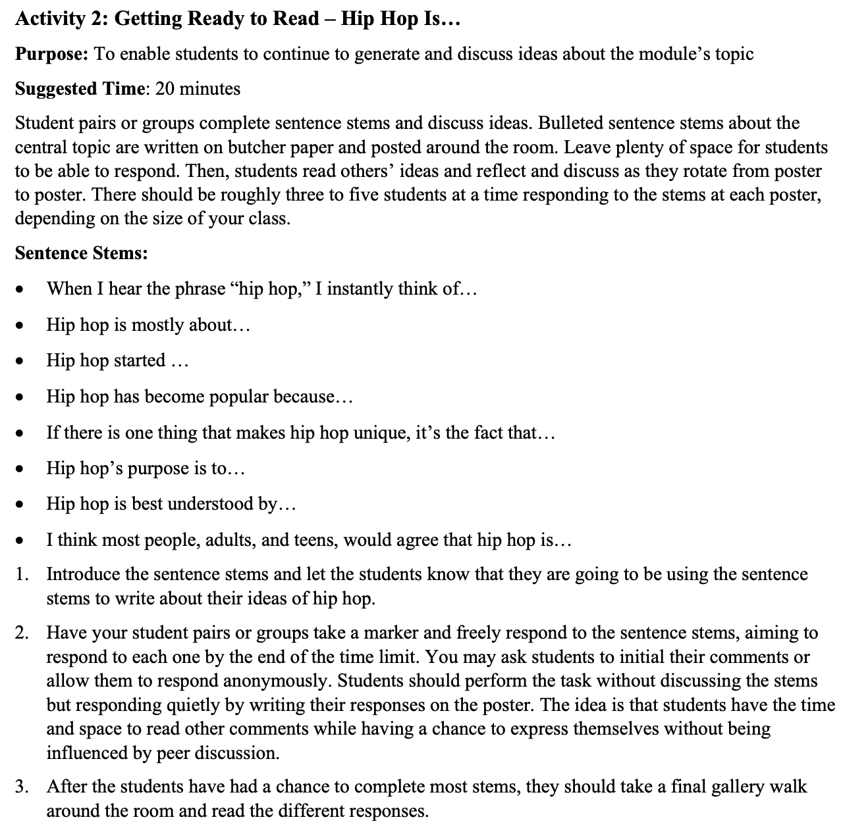
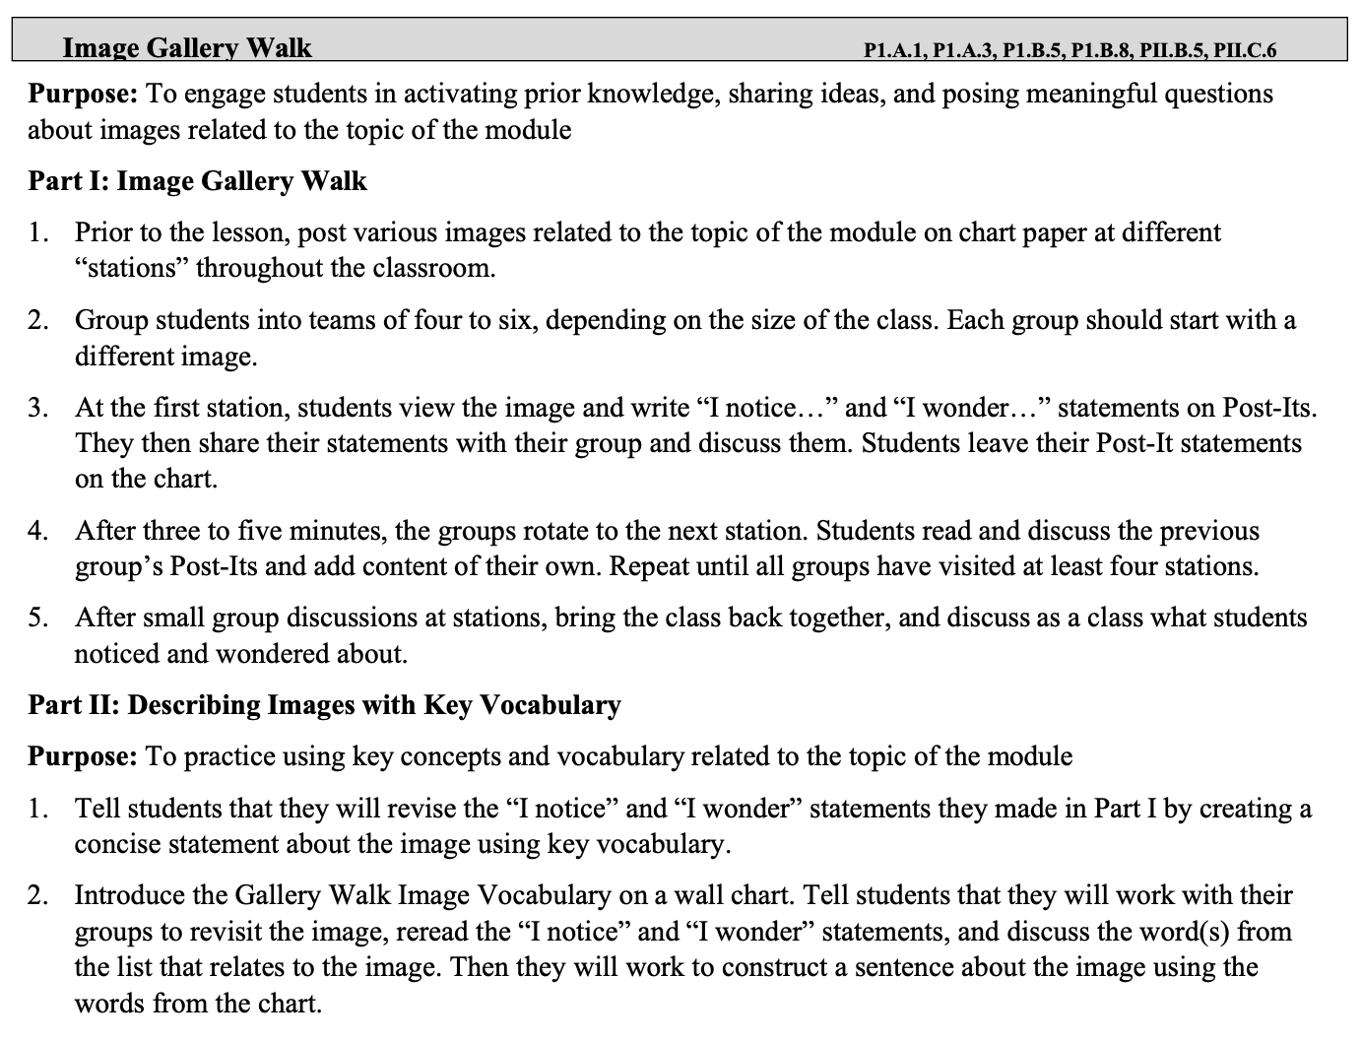

Slide 5
Brainstorming
~Think, pair, share: thinking about the digital tools we’ve seen, what are other ways we might use Artsteps in the ERWC classroom?
~Given the students you teach, what affordances and/or challenges do you foresee if you were to implement Artsteps in your classroom?

Slide 6
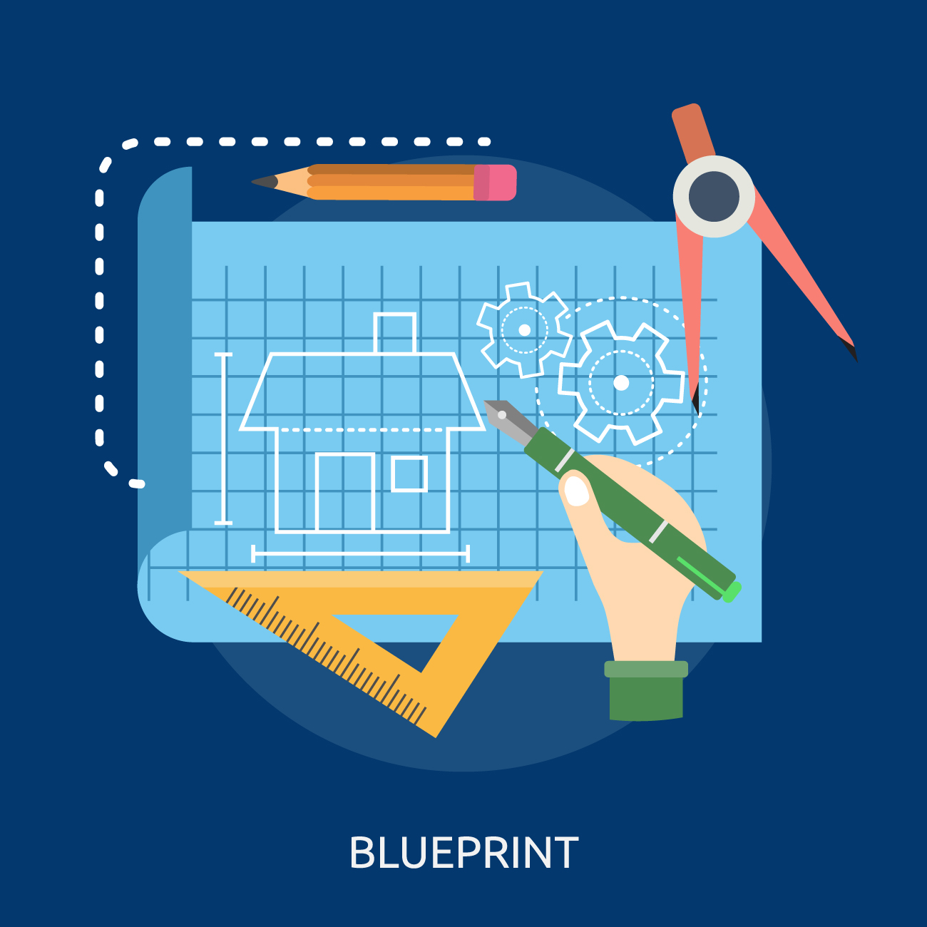

Slide 7
Works Cited
Katz, Mira-Lisa, et al. "Expository Reading and Writing Curriculum (ERWC) Theoretical
Foundations for Reading and Writing Rhetorically." ERWC Online Community, pp. 1-15.
McLean, Cheryl A. “A Space Called Home: An Immigrant Adolescent’s Digital Literacy
Practices.” Journal of Adolescent & Adult Literacy, vol. 54, no. 1, 2010, pp. 13–22.
Paris, Django, and H. Samy Alim, editors. Culturally Sustaining Pedagogies: Teaching and
Learning for Justice in a Changing World. Teachers College Press, 2017.

