Slide 1
ERWC Leadership Certification 2024
Notes:
Ginny

Slide 2
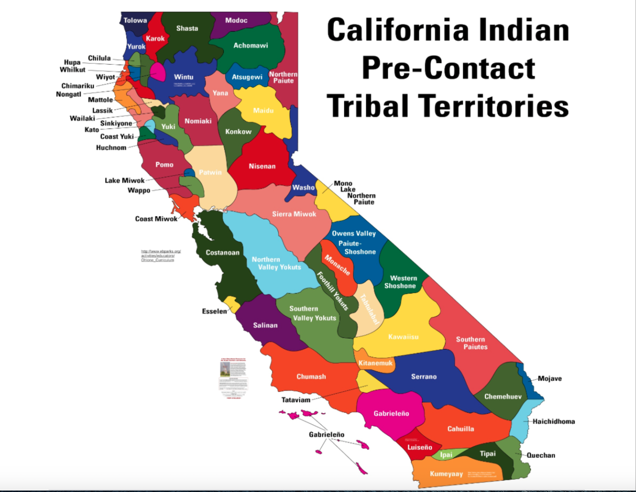
Welcome
Welcome and acknowledgements
We acknowledge that our Professional Learning (PL) takes place on unceded territories in California, home to nearly 200 tribal nations. As we begin this PL, we acknowledge and honor the original inhabitants of our various regions. A land acknowledgement is a critical step towards working with Indigenous communities to secure meaningful partnership and inclusion in the stewardship and protection of their cultural resources and homelands. Let’s take a moment to honor these ancestral grounds that we are collectively gathered upon and support the resilience and strength that all Indigenous people have shown worldwide.
We acknowledge that this Professional Learning (PL) is taking place throughout the unceded territory of California, home to nearly 200 tribal nations. As we begin this PL, we acknowledge and honor the original inhabitants of our various regions. A land acknowledgement is a critical step towards working with Indigenous communities to secure meaningful partnership and inclusion in the stewardship and protection of their cultural resources and homelands. Let’s take a moment to honor these ancestral grounds that we are collectively gathered upon and support the resilience and strength that all Indigenous people have shown worldwide. We conduct this PL in xxxxx which is on the traditional unceded territory of the xxxxxxxxxxxx.
Notes:
Ginny

Slide 3
Leader Certification Goal: Prepare for Introductory Professional Learning for 2024-2025
Notes:
Ginny

Slide 4
Agenda
Welcome and Announcements
Review Changes to the PL
Furthering an Understanding of Multilingualism
ELD Updates
Culturally and Linguistically Sustaining Pedagogies – New Activities
Final Reflection – New Activity
Breakouts According to Regions for Planning
Feedback on Selections of PL Draft Guidelines
Two-Day Intensives Information and Request for Feedback
Reflection and Feedback
Notes:
Ginny

Slide 5
Statements for Professional Learning
•Diversity, Inclusion, Equity: Our intention is to be open to the diversity that participants bring as far as ability, age, language, gender, race and ethnicity, sexual orientation, religion, or immigration status – and also draw on these resources for engagement in the content and practices in the PL.
•Accessibility: We all learn differently, we may need different or additional support when learning, and, as facilitators, we are committed to a PL that best addresses levels of need and learning styles.
•Language: We support a multilingual and multidialectical use of language as a resource for engagement, learning, and expression.
The full “ERWC Statements for Diversity, Inclusion, Equity, Accessibility, and Language” can be found in the Learning Focus 1 resources for this PL.
Notes:
Ginny

Slide 6
Mindful Agreements for Collaboration
Seek to Understand: Be curious and listen deeply.
Embrace “Yes and”: Build on each other’s ideas.
Share the Air: Step up, step back, invite others in.
Be Present and Visible (when possible): Resist the urge to let the outside world distract you.
Take a post-it: Write down the one agreement you’ll focus on intentionally today. Give yourself a + each time you fulfill it.
Notes:
Ginny

Slide 7
Announcements and Updates

Slide 8
Director Announcements
New Director
Contract with Stanislaus: 4 Day Introductory
Intensives: 2 Day Pilots (2024-2025)
Leadership Certification 2025…and beyond

Slide 9
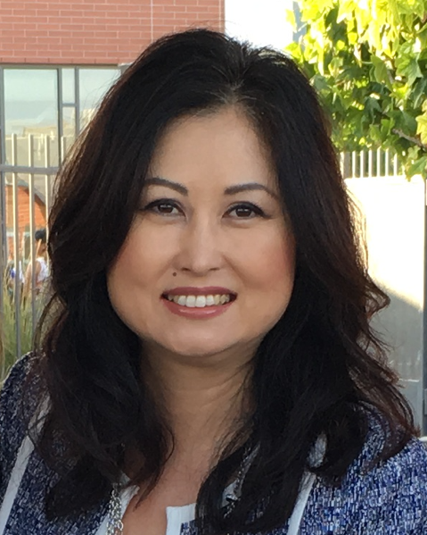
New Director
Cyndi Paik, Ed.D.
Cyndi is an experienced educational leader with a strong background in PK-12 public schools. She has served in variety of roles including as a teacher, literacy coach, principal, Assistant Superintendent of Educational Services, Superintendent, Adjunct Faculty, Dissertation chair and Leadership Coach. With a passion for improving education and empowering students, she has dedicated her career to addressing the needs of diverse student populations and creating opportunities to ensure that all students can succeed in college, career and life. Her expertise is in the areas of leadership, curriculum development and strategic planning.

Slide 10
ERWC Introductory Workshops
Regional Leads/R11 EAP Coordinators will request a workshop by filling out the request form that Kia Ross will provide for you.
Once your workshop request is in you will receive a link for registrations that you can monitor yourself
You will receive your customizable Canvas course shell the week of your workshop start date.
The workshop leads will be responsible for certifying each participant as a certified ERWC teacher by sending the list of Certified Teachers to Kia.
Notes:
Zee

Slide 11
2 Day Intensives
There are 10 being piloted in 2024-2025
They will be available for dissemination in summer of 2025
The developers are planning them as we speak and we will decide on certification to teach these as they are developed and we know more of what it will take to facilitate the workshops.
They are being planned as F-t-F, hybrid, or online.
Allocations to the regions will be based on number and need
Issues and Concerns we need to be aware of?

Slide 12
List of 2 Day Intensives
Project Name | Developer
EWC and Universal Design for Learning | Ginny Crisco
Writing Rhetorically | Christy Kenny- Kitchin
Planning a Year-long ERWC Course | Debra Robinson
Writing Instruction | Debra Robinson
Preparing to Teach: It’s All About the Text! | Debra Robinson
Building Language and Literacy in ERWC-ELD Classrooms | Roberta Ching
Supporting the Transformative Social and Emotional Impacts for Students’ Success in ERWC | Mariam Catania-Schultz
Teaching Literature Rhetorically | Jennifer Fletcher
Teaching for Transfer | Jennifer Fletcher

Slide 13
Leadership Certification 2025 and beyond
Moving to every other year certification
Will be north or south depending on CATE
2025 will be South–2026 will be north
You will certify in your region during your certification year
On the year we are not certifying, we will try to have an ERWC strand and table at CATE that will provide updates and an opportunity to stay connected
If there are updates needed in the interim year, the non-certifying group will have a online update opportunities with the CISC Meeting, the STAN Co Office meeting, and the EAP Coordinators meeting.

Slide 14
Canvas Course Information
Workshops can be face-to-face or asynchronous.
There is still the option to hold asynchronous workshops. Be clear in the description if there are any required Zoom meetings.
Each professional learning team will get a Canvas shell for either face-to-face OR asynchronous learning. Customizations are possible within that shell. During the next workshop, your former shell can be copied for the new PL.
You are in Teacher Mode in the Canvas Shells: Please do not make changes to the shell since it will change it for “all” the participants here today.
Notes:
Zee

Slide 15
Resources
Online Community: http://writing.csusuccess.org
Introductory (Asynchronous) Course: https://csuco.instructure.com/courses/2590
Introductory (Face-to-Face) Course: https://csuco.instructure.com/courses/2591
Leader Certification Folder for Participants: http://bit.ly/3VyscwS
Notes:
Ginny

Slide 16
Special Thanks to the PL Committee
Jennifer Beall
Mariam Catania-Schultz
Ginny Crisco, Chair
Nelson Graff
Dutch Henry
Marcy Merrill
Debra Robinson
Notes:
Ginny

Slide 17
The PL Committee Seeks Volunteers
Work with the PL committee on revising the introductory PL and other needed PL related business
Meet weekly March-June. Otherwise meet monthly or not at all. No summer meetings (after the June leadership conference)
Meetings are scheduled based on member availability
If interested, email Ginny Crisco at vcrisco@csufresno.edu OR provide us your name and email in the feedback form (where it requests interest in volunteers).
Notes:
Ginny

Slide 18
Break Time
(15 minutes)
Check out the Resources for Next Level Professional Learning:
https://linktr.ee/CSUERWC

Slide 19
Review of Changes to the Introductory Professional Learning
Notes:
Ginny

Slide 20
Introductory PL Revision Overview
Revisions were based on
The PL committee’s experiences with PL (not able to do surveys this year)
Manage the time, support teacher planning, highlight ERWC resources
Key Revisions included
Juvenile Justice replaced Language, Gender, Culture
New series of planning a module activities in Learning Focus 2
Activities that pull in our Next Level Professional Development
Notes:
Ginny

Slide 21
Overview of Revisions to PL
Review “2024-25 Changes to Professional Learning” in the drive folder
Based on what you know about your participants, generally, discuss what would be your top 5 priorities to emphasize in your PL for this next AY?
Notes:
Ginny

Slide 22
“Furthering an Understanding of Multilingualism”
Dr. Zee Cline
Notes:
Zee

Slide 23
National Professional Development Grant for Middle School ERWC-ELD Updates
Notes:
Robby and Debra

Slide 24
CURRENT PROJECT: EXTENDING THE PIPELINE TO MIDDLE SCHOOL
5 year Federal Grant (OELA), including development, piloting, and data analysis
2021-2022: Curriculum Development
- 6 modules per grade 6-8
2022-2023: Developing Professional Learning & Participant Recruitment
- PL for Teachers, Coaches, Administrators
- Recruit approximately 98 (ELA-ELD) teachers from 11 districts and 22 K-8 and/or middle schools from the Sacramento and Central Valley Regions
2023-2024: Supporting Pilot
- 1st Summer Institute, coaching visits, community of practice meetings, data collection
2024-2025: Study Year
- 2nd Summer Institute,​​​​ include Sac State Preservice candidates, coaching visits,
community of practice meetings, data collection. Curriculum posted to online community
2025-2026
- Data Analysis, Dissemination, publish curriculum

Slide 25
ERWC-ELD Middle School Modules
Grade | Semester 1 | Semester 2
6th | Facts of Life (Gary Soto) Keeping California Wild | The Metaverse and Me Booked (Kwame Alexander)
7th | Sharing Stories, Creating Community When You Trap a Tiger (Tae Keller) | My Language Journey They Called Us Enemy (George Takai) Water Protectors
8th | Living Beyond Borders, Growing Up Mexican in America (Margarita Longoria) Our Plastic Addiction | Songs of Praise Bees: Technology versus Nature The Underground Abductor (Nathan Hale)
Notes:
Highlighted modules not available yet.

Slide 26
Qualitative Evidence:
NPD ERWC-ELD 9th and 10th Grade Study (2016-2021)
Teachers frequently remarked on strong student interest in the module topics and texts;Teachers of designated ELD classes were particularly positive about students’ engagement.
“[The number] of activities they have to do in class keeps kids engaged. Enough to keep them going. Activities are short/challenging.”

Slide 27
Qualitative Evidence:
NPD ERWC-ELD 9th and 10th Grade Study (2016-2021)
“I plan on teaching this module [The Absolutely True Diary of a Part-Time Indian] basically forever because it proves that you do not need classic literature for students to be able to learn and apply vital reading and writing skills.”
“When it clicked for them, it stuck. They can now use the classical pattern to formulate well-constructed arguments and not even just in writing.”

Slide 28
Qualitative Evidence:
ERWC-ELD 9th and 10th Grade Study
Teachers positively described students’ increasing familiarity and confidence with focal skills and task completion.
The second most common success that teachers and coaches reported—after strong student interest and engagement—was that students were building skills in writing, reading, discussion, and critical thinking. The skills that teachers described included the following:
Participating in sustained, in-depth, academic discussions
Reading comprehension
Listening in class
Having stamina for reading longer texts or engaging with a text repeatedly
Having confidence with public speaking
Asking better questions

Slide 29
Testimonials at Delhi USD
School Board Meeting
“With ERWC, I felt I was part of the story.”
“ERWC helps bring the curriculum to life.”
Very effective for sped students, gifted students, and students who will be going straight into the workforce.

Slide 30
Lessons Learned
California ELD landscape is extremely complex
The ERWC-ELD model requires a large shift for teachers
Achieving student-centered classrooms requires well-designed protocols and teacher PL
Language focus belongs is central to both ELA and ELD classes
Reading challenging texts is challenging!
Mentor texts and robust writing instruction are essential

Slide 31
LF 4.5 Culturally and Linguistically Sustaining Pedagogies
Notes:
Ginny

Slide 32
Webinar Review and Discussion
Using the handout “Supporting Culturally and Linguistically Sustaining Pedagogies” in the Overview documents for Learning Focus 4, select 2-3 webinar clips to watch (about 15 min).
Be prepared to discuss with a small group what your take aways are for how these excerpts support Culturally and / or Linguistically Sustaining Pedagogies.

Slide 33
Debrief Using Structured Discussion (HIST)
Step One: Participants get into groups of 4 and number off: 1, 2, 3, and 4. Participants 1 and 2 will discuss the topic for four minutes while participants 3 and 4 take notes in a T-chart. The T-chart will be a record of the main points and examples discussed by participants 1 and 2.
Step Two: Participant 3 now summarizes the discussion and then asks for elaboration or clarification on one underdeveloped but important point AND joins the conversation while participant 4 continues to take notes in a chart that has three columns (on the flip side of the page, for example).
Step Three: Participant 4 now gives credit to individuals for significant ideas and synthesizes the work of the group into a short statement.
Step Four: Discuss as a large group how the activity and conversation can help you to sustain your students cultural and/or linguistic resources.

Slide 34
LF 4.9 Review Your Personal Learning Goals
Notes:
Nelson

Slide 35
Reflecting on Personal Learning Goals
Find the learning goals that you set for yourself in Learning Focus 1
Reflect on your progress toward those goals.
Brainstorm 1-2 questions you still have
Now go to the online community and try to find resources to answer your questions.
Resources include:
About ERWC>Research, Evaluation, and Scholarship OR Teaching Resources
Events> Webinars OR Blog
You might use the “Reflecting on Your Learning Goals Graphic Organizer” in LF 4.9 to document your reflections and notes about your next level ERWC Professional Learning
Notes:
Nelson
In the Final Reflection on Learning: The ERWC 12 PortfolioActions module, students engage in a thorough, evidence-based examination of their work throughout grade twelve in ERWC and write a portfolio reflection letter based on that examination so that they learn more about what they have learned and how they have learned it. You will complete a similar task here. An important part of learning is not only making challenging learning goals, but also reflecting on progress toward those goals and then making new goals to continue the practice. In this case, we ask you to reflect on the learning goals you created on the first day of the workshop as a way to support you in continuing to develop to teach reading and writing from a rhetorical perspective.

Slide 36
Lunch Time!
Check out the resources for Next Level Professional Learning, including recordings from the webinar series, the ERWC blog and podcasts, the ERWC Literacy Conference in June (locations in both Southern and Northern CA), and be sure to follow ERWC on X, Instagram, Facebook, and LinkedIn.
You can find links to all of these resources at https://linktr.ee/CSUERWC

Slide 37
Breakouts According to Region for Planning
Notes:
Marcy
Look at planning resources and new materials
Discuss how your region will approach asynchronous or synchronous PL

Slide 38
Acquiring Feedback on Professional Learning Draft Guidelines
Notes:
Nelson

Slide 39
ERWC 2 Day Intensives
Notes:
Debra

Slide 41
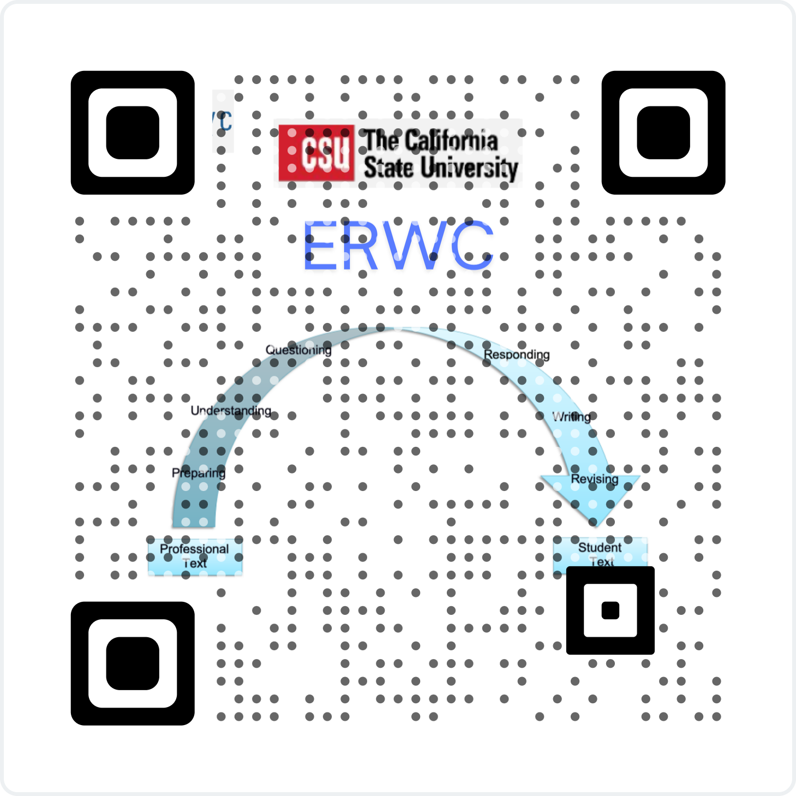
Congratulations!
Final Reflections and Feedback
Notes:
Mariam to add QR code and bitly for Leadership Certification Survey linked below
https://forms.gle/7jRYNsWnQEA8391x5
Any other information I should add here?
Am I creating the Feedback form, I can create a draft for approval from the group?

Slide 42
Regional Lead Meetings Reminder
Monthly
CISC 10:30 A.M. to 11 A.M.
Quarterly
Chris Eddings ceddings@stancoe.org
Notes:
Mariam

