Slide 1
Introduction to the Expository Reading and
Writing Course (ERWC)
Leadership Event: June 2024
Dr. Marcy Merrill (merrills@csus.edu)
Notes:
The California State University

Slide 2
Agenda
Welcome, introductions (5 min)
Where we have been, where are now, where are we going? (ERWC history, goals, mission, EAP) (15 min)
Trying it on: ERWC in practice (70 min)
a. Where materials are housed
b. Template and ARC
c. Modules: what they are, how to use them, affordances
  1) mini module
  2) Full length module
d. Features and extra learning about ERWC
Notes:
Adjust the agenda to fit your audience and your needs.
Consider providing an online resource for powerpoints and handouts (line Padlet or Google Docs. Use a QR code to link easily.
Consider posting a “parking lot” for participants to write questions/comments they don’t want to bring up orally or that might be slightly off topic.

Slide 3

Introductions and goal setting (5 min.)
Brief introductions (name, where you work, why you came to this session?)
Norms and HAT WEARING: learner/ participant/presenter of ERWC
Overview of double-session agenda
Description of materials
What IS ERWC?
What are your goals for attending the ERWC leadership conference?

Slide 4
Professional Learning Norms
Limit distractions and interruptions
Minimize side conversations and multi-tasking
Participate when you can; take notes when you wish.
Communicate with me about any other needs and/or feedback you might have, and we will work together to ensure they are met
Notes:
Introduce norms and remind each other that we are professionals. Ask participants at the table to discuss what reminders they might need to stay focused.

Slide 5
II. Where we have been, where are now, where are we going? (ERWC history, goals, mission) (10 m.)
ERWC adoptions beyond CA
What is ERWC?
Early Warning: Identify students before their senior year who need to do additional work in English and/or mathematics before entering the CSU.
Collaborate with High School Community: Inform students, families, and high schools of students’ readiness for college-level work and partner with high school teachers and administrators to develop solutions.

Slide 6

Why ERWC?
To bridge the gap between high school standards and college expectations in order to decrease the number of incoming college students who require remediation in English
High School
College
Notes:
Use this to introduce the creation of ERWC, the background and the need.

Slide 7

Adopted Course for Grades 11 and 12
Module Types
  Portfolio Modules (Introductory and Final)
  Mini-Modules (Choose 3 during the year.)
  Full-Length Modules including Book, Drama, Issue, and Foundational (Grade 11) that are intended to reinforce strategies or concepts introduced in Mini-Modules (Choose 5-6 during the year)

Slide 8
Modules for Grades 9 and 10 with Integrated and Designated ELD Support—& the call is out for new modules with our GIANT GRANT AWARD
Grade | Semester 1 | Semester 2
9 | Conscious Hip Hop Good Food, Bad Food | Remembering Injustice Absolutely True Diary of a Part-Time Indian
10 | Age of Responsibility Citizen Youth | Things Fall Apart We Should All Be Feminists Free Speech

Slide 9
Modules Available for Grades 7-8 NOW, but….more to come! This year is the final pilot for the NEW middle school modules.
Grade 7
What It Takes to Be Great
Tap vs. Bottled Water
Helicopter Parents
The Impact of Celebrities
Grade 8
Social Networking or Antisocial Networking
When is Lying Okay?
Robots in School
The Construction of a College Experience

Slide 10
Grade 7
Sharing Stories, Creating Communities
When You Trap a Tiger
My Language Journey
Activity Details
They Called Us Enemy
Grade 8
Living Beyond Borders
Songs of Praise
Our Plastic Addiction
Underground Abductor
Bees: Nature vs Technology
Grade 6
Facts of Life
Keeping California Wild
The Metaverse and Me
Booked

Slide 11
UC’s A-G Course Management Portal
Official title: CSU Expository Reading and Writing
Official abbreviation: ERWC
Must a school use the official title?
  Yes, if the school wants to make it easy for offices of admissions to identify the course
  It’s possible that variations will be honored but not guaranteed
  http://www.ucop.edu/agguide/updating-your-course-list/2015-16/index.html

Slide 12
Key Principles (share your most critical ONE )
The integration of interactive reading & writing processes
A rhetorical, inquiry-based approach that fosters critical thinking & engagement through a relentless focus on the text
Materials & themes that engage student interest
A student-centered approach that emphasizes student agency & metacognition
Classroom activities designed to model & foster successful practices of fluent readers and writers
Research-based methodologies with a consistent relationship between theory & practice
Built-in flexibility to allow teachers to support students’ development as expert learners & respond to instructional contexts
Alignment with State Standards for English Language Arts/Literacy & English Language Development
Notes:
Key Principles : examine these 8> Which ONE (I know there will be many) stands out to you as most critical for your learners or as a goal for you to set for your own teaching or leadership role with ErWC? Why?

Slide 13
Research on our successes over the past 20 years can be found at:
https://writing.csusuccess.org/about/research

Slide 14
Goals for 4 days of ERWC Professional Learning: to provide background in ERWC and its use with middle and high school students. We will share resources (online community, modules, research/best practices…) and strategies and pedagogy to make sure you feel confident teaching ERWC online this year and beyond.
Familiarize yourselves with the ERWC professional learning site, modules (and mini modules), and the general principles behind the development and “bones” of the curriculum (the arc and template).

Slide 15

Setting Personal Learning Goals
At the end of a 4 day professional learning sequence, teachers should be prepared to teach ERWC modules
After scanning the ERWC key principles and course description, generate 1 or 2 personal learning goals for today.
Notes:
Encourage participants to take notes, either electronically or on paper, in a place they can readily access at the end of the day and at various points

Slide 16
Experiencing ERWC Pedagogy and Rhetorical Thinking as a Learner: Synchronous and asynchronous responsibilities
Notes:
The California State University

Slide 17
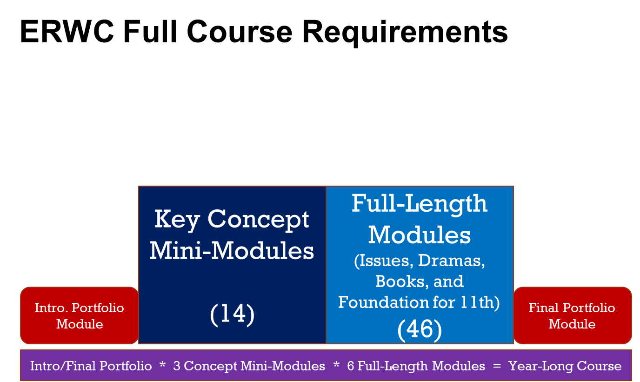

Slide 18
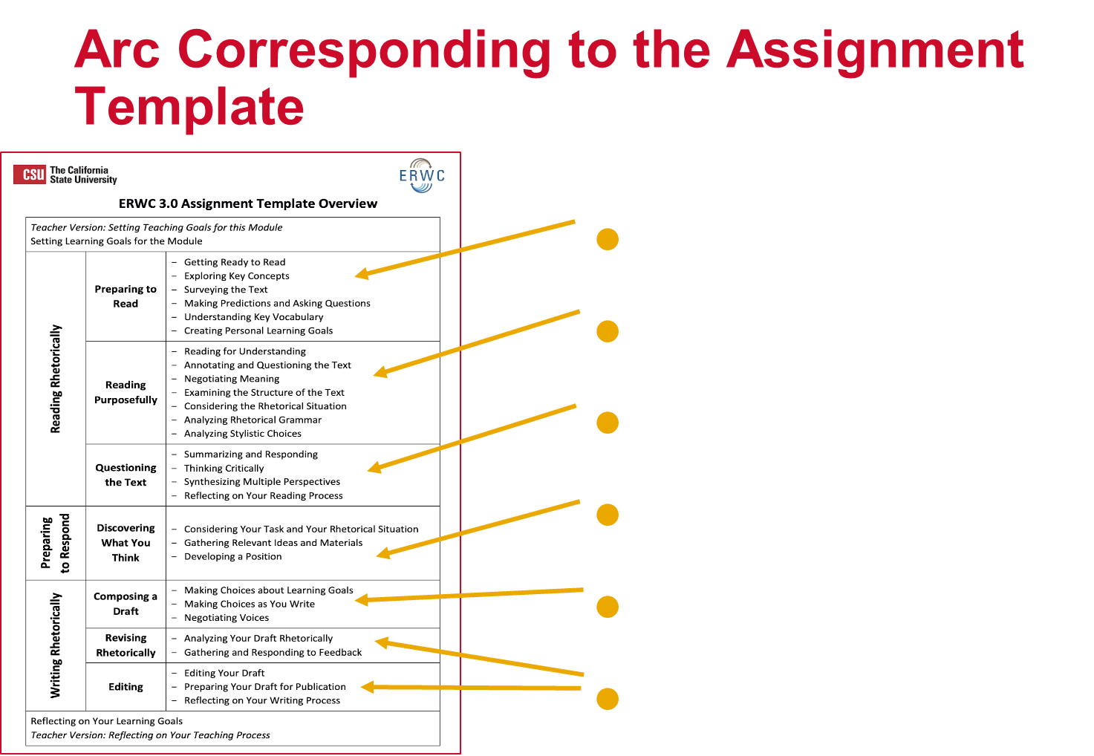

Slide 19
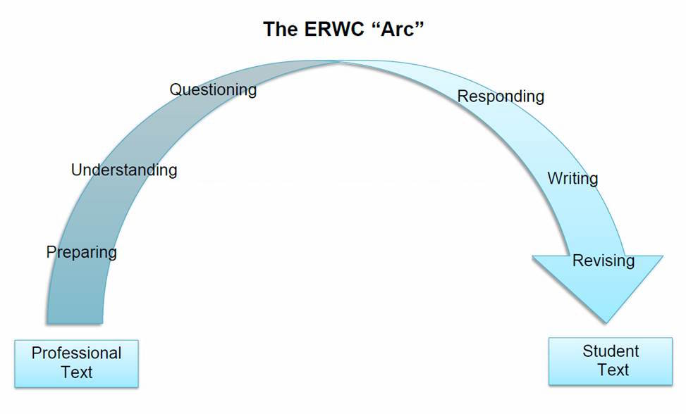
•How might you help teachers build a conscious awareness of the process for engaging with, responding to, and writing a text, as outlined in the Arc and the Assignment Template, for students in your classroom?
Notes:
Talk about the process of moving from text to text. That students should constantly be evaluating their readings as potential authors, and that when they sit down to write the texts they have read become models for their own work—novice writers can and should emulate the moves that competent writers make, which is different from just copying the words that they use.

Slide 20
Trying it on: ERWC in practice (80-90 m)
Learning about Rhetoric

Slide 21
Rhetorical
Triangle
Text/Logos
Author/Speaker/Ethos Audience/Pathos

Slide 22
Author’s Rhetorical Situation
Logos Text
Ethos Author
Pathos Audience
Author’s choices | Specific effects on a particular audience | How those effects serve the author’s purpose
Notes:
Use Introduction to Rhetoric adapted from Ramage and Bean to explain the rhetorical situation.

Slide 23

Message
Logos
How can I make the argument internally consistent and logical? How can I find the best reasons for this audience and support them with the evidence this audience will find most convincing?

Slide 24
Writer or Speaker
Ethos
How can I present myself effectively for this audience? How can I make it more likely that this audience will find me credible and trustworthy?

Slide 25

Audience
Pathos
How can I make the reader open to my message? How can I best appeal to the reader’s values and interests? How can I engage my readers emotionally and imaginatively?

Slide 26
Logos, Ethos, Pathos
Author’s choices | Specific effects on a particular audience | How those effects serve the author’s purpose
Notes:
The purpose of this activity is to help teachers develop particular understandings of the Aristotelian appeals that are sometimes misunderstood:
Analyzing ethos, pathos, and logos has less to do with identifying particular words or portions of text as pertaining to each appeal. Rather, the appeals represent different ways to understand each part of the text. The same words (evidence, arguments, reasons, illustrations) have consequences for the establishment of the writer’s ethos, for the logic of the argument, and for the emotional responses of the readers.
The impact of any choice the writer makes in terms of the three appeals is always dependent on the audience (for all three appeals).
As writers, students should always be thinking first of the audience—what a particular audience will find logical and emotionally compelling, and the way choices the author makes have consequences with a particular audience for her ethos.

Slide 27
Transferable Rhetorical Concepts in ERWC
ERWC 3.0 includes mini-modules that introduce students to transferable rhetorical concepts or skills.
Read through the list and identify modules that are new to you to investigate thoroughly.
Introducing the Rhetorical Situation | Reviewing the Rhetorical Situation
Introducing Ethos, Pathos, and Logos | Introducing Stasis Theory
Introducing Genre as Rhetoric | Introducing the Toulmin Model of Argumentation
Introducing Kairos | Introducing Exigence
Analyzing Audience: Pathos as Inquiry | The Classical Pattern of Persuasion
Notes:
Depending on the timing of the day, you could have teachers skim one of the mini-modules and share out what they learn. It may be worth noting that there are other mini-modules, such as Introducing Transfer of Learning, Introducing Inquiry Questions, and Becoming Assessment Savvy, but these focus specifically on rhetorical ideas.

Slide 28
Expository Reading and Writing Curriculum
Introducing Rhetorical Situations
Mini-Module
Notes:
28
Use the leader version of the mini-module to guide this activity with your participants. Please refer to the notes (marked with ❖) interspersed throughout the leader version for information about engaging your participants as learners in the mini-module.

Slide 29
Reading for Understanding
Read the scenario and underline portions that will help Ms. Bipkins resolve her problem. Make margin notes for comprehension, pose questions you need to be answered.
Introducing the Rhetorical Situation, Scenario
Ms. Flavia Bipkins, a wealthy Bay Area philanthropist and art collector would like to donate a painting to the Children’s Memorial Hospital in San Francisco. The painting would hang in the Family Lounge in the Surgical Center of the hospital. This is where families wait, sometimes for long periods, while a young family member undergoes surgery. As one might imagine, the wait is often stressful, while the family members worry about the successful outcome of the medical procedures.
Problem: Flavia Bipkins has an extensive art collection, which she treasures. She has narrowed down her choices for the donation to four paintings. She will give the hospital only one. Since she is a very caring human being, she does not want her attachment to the paintings to influence her choice. She seeks your guidance in making the selection. Which is the most appropriate painting to adorn the Family Lounge at Children’s Memorial Hospital?
Once you have made your decision, write a letter to Flavia Bipkins share what you think of her choices and explain which painting you recommend for the Family Lounge.

Slide 30
Thinking Critically about the Rhetorical Situation
When you read the description of the situation, you should notice two different rhetorical considerations about which you must make decisions: the setting of the waiting room and the occasion of your letter to Ms. Bipkins.

Slide 31
Discuss your responses to the following 3 questions.
What purpose(s) should the paintings hanging in the waiting room serve for their audience, the “. . . families [who] wait, sometimes for long periods, while a young family member undergoes surgery”?
What do those families have in common and how might they differ?
What “rules” can you generate for selecting a painting that would be appropriate for the waiting room?

Slide 32
Expository Reading and Writing Curriculum
Experience a Full-Length Module as a Learner
Notes:
32
Use the leader version of this module to guide this activity with your participants. Please refer to the notes (marked with ❖) interspersed throughout the leader version for information about engaging your participants as learners in the module.

Slide 33

Juvenile Justice

Slide 34
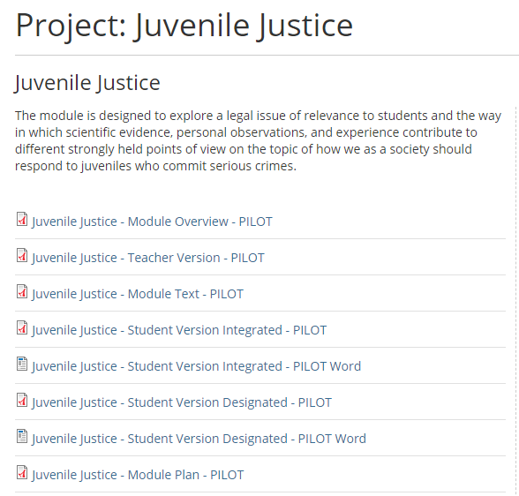
Navigating an ERWC with ELD Module
A Module Plan shows the alignment of specific activities to the ELA/Literacy and ELD standards and lays out a suggested pacing plan for implementation of the module.

Slide 35
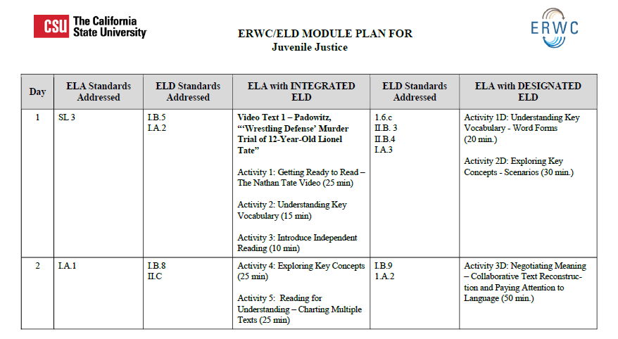

Slide 36
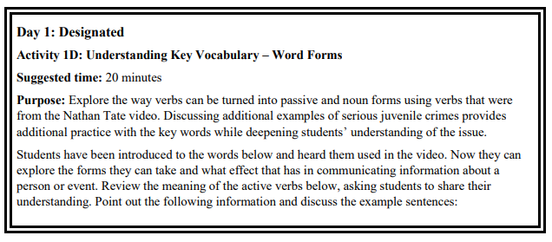
Features for EL modules:
Double Lines for Designated

Slide 37
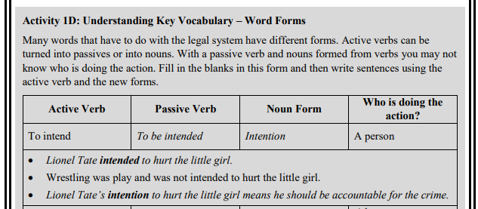
Features for EL modules:
Shading for Student Activities
Examining, using/applying, and ASSESSING word forms

Slide 38
Begin with the Task
Students write an open letter (an opinion piece) to be published on a website for those interested in the issue of juvenile crime, particularly state policymakers. Students use what they have learned about the issues surrounding charging and sentencing juveniles and about juvenile brain development through reading and discussion about the implications for juvenile accountability and rehabilitation. They apply what they have discovered about analyzing the rhetorical situation and the genre of the open letter to create their own letters tailored for their intended audience in order to make the argument for their position on juvenile sentencing.

Slide 39
Juvenile Injustice: Charging Youth as Adults is Ineffective, Biased, and Harmful - Executive Summary
Excerpt from the Full Juvenile Justice Report: About This Report
  This report aims to centralize the experiences of incarcerated youth of color, formerly incarcerated individuals, and their family members. Much has been written about juvenile system reform in general and juvenile transfer laws in particular. All too often, the voices of system-involved youth and their families — the people most impacted by these policies — are absent from these accounts and analyses. By contrast, the content of this report is grounded in the personal narratives of focus group participants, the expertise of community organizations that work with system involved families on a daily basis, and public health research.
Now what can you predict about the report? What is its purpose?
What arguments does this text (the 5th of the module) contribute to the conversation about how the criminal justice system can best deal with juveniles who commit serious crimes? What kind of evidence supports the arguments?
Notes:
This is the fifth module text. Students already know how to annotate, so they can do this independently without the teacher modeling. It’s student-centered and inquiry-based, so students talk to each other about what they have discovered. Considering intertextuality (analyzing how the text supports or contradicts what the previous texts have said) prepares students to join the conversation when they write their own open letters.

Slide 40
Negotiating Meaning - Sentence Unpacking
Original sentence
Several large-scale studies / have found higher recidivism rates / among juveniles tried and sentenced in adult court / than among youth charged / with similar offenses in juvenile court.
Activity 16D

Slide 41
Several large-scale studies
What are studies? Who is probably being studied?
What is a study that is large-scale?
have found higher recidivism rates
What does recidivism mean? So what is a higher recidivism rate?
What does the word “higher” indicate is going to follow?
What did the studies show?

Slide 42
Negotiating Meaning - Sentence Unpacking
among juveniles tried and sentenced in adult court
What words are needed to make “tried and sentenced in adult court” a complete clause with a subject and a verb? Why can those words be left out?
So which juveniles had the higher rates of committing new crimes (recidivism)?

Slide 43
Negotiating Meaning - Sentence Unpacking
than among youth charged
What does “than” do?
Can you guess what comparison is being made?
with similar offenses in juvenile court
Does this confirm your guess?
What is an example of “similar offenses?”

Slide 44
Considering the Rhetorical Situation
Ethos & Logos
Pathos
Why did the writers tell their readers that “This report aims to centralize the experiences of incarcerated youth of color, formerly incarcerated individuals, and their family members?” in the About This Report section at the beginning?
Why did they include the quotation from Malachi right below the title? What is the intended effect?
Why did the writers include an Executive Summary? What will the effect be on the intended audience?
What design features (the way the text is set up on the page) appeal to the intended audience?
What kind of evidence did the writers provide? How did they let readers know that their evidence was based on research, not opinion? Give some examples. What effect will this have on the intended audience?

Slide 45
APPLYING THE SKILLS LEARNED: transfer learning by Editing a Sample Student Essay
Read the following student essay on the topic of sentencing juveniles to life in prison. Combine clauses with coordinating words, subordinating words, and transitions. Circle the connecting words that you use to combine independent clauses, and check that you have punctuated your sentences correctly.
  Garinger has the belief that violent children are able to “grow out of crime.” There is a child in prison facing a life sentence. He killed his abusive parents. He can sit there. He can take steps towards improvement. Scott Anderson told the story of Greg Ousley, who killed both his parents. He was in prison. He worked to improve himself. Ousley was able to get an education. He made sense of what he did. It took many sessions of psychological counseling. He was determined to understand why he committed his crime. That is someone who does not want to continue going into the pit of darkness.

Slide 46
Analyzing Your Draft Rhetorically
How can you help students identify and evaluate the rhetorical choices made in their draft in light of their rhetorical situation?
How can you help students make moment-by-moment choices about implementing genre conventions, selecting relevant and compelling evidence, and discovering the most effective organizing strategy for their text?

Slide 47
_____’s (author) claim that ___ seems to have contributed to ____ seems unlikely because…
I agree that ___may have happened because…____
Though it seems obvious that _____, there is evidence from ______ that proves otherwise.
Essentially I am arguing that ____
My point is_______
In the _____(essay or paper title), _______ (author) states that…..
Although many people agree with ______’s (author) stance that ________ (idea) occurred, others consider_____ to have happened.
Writing instruction
How can you help students learn to quote, paraphrase, and summarize their sources appropriately and document them accurately?
How can you help students represent the dialogue between their own views and their various sources?

Slide 48
Know your students
What are their learning goals?
What is their home language?
What is the reading proficiency of your students who will read this text?
How fluent are the readers in your class?
How do they do with comprehension tasks? How aware are they when they struggle? What reading strategies do they employ?
What is the background knowledge needed for the students who will read this text? Will their background knowledge need to be activated?
Do they have background knowledge necessary to build schema for this text and contribute to comprehension of the argument or narrative?
Are students familiar with the purpose and expectations of the genre? Is this an ordinary or unusual use of the genre?
What is the motivation of your students who will read this text?
How motivated are they to read?
How motivated are they to read this text?
How is this piece going to be relevant and engaging to my students?

Slide 49
Activity 17: Reflecting on Your Reading Process Provide evidence and examples documenting your ability to perform each of the tasks in the chart.
I am able to... | Evidence and Examples
Identify thesis and/or major claims
Connect evidence to claims
Analyze writers’ language choices
Annotate and question texts
Analyze text structure
Describe the effects and purposes of writers’ moves

Slide 50
Features, resources, & extra learning
Materials: texts: Teaching Argument and They Say I Say & ONLINE COMMUNITY, as well as resources such as: Theoretical Foundations, Essential Pedagogies, high impact strategy toolkit
Common Core Integration
Instructional moves: How to scaffold, use gradual release of responsibility, and modeling
Concepts: Transfer, Formative assessment
Sharing ways to reconfigure your four days if you will provide professional learning

Slide 51

“When we teach students to think about arguments rhetorically, we build up their powers of observation. We want students to pay closer attention to the acts of meaning around them ... “ (Fletcher xvii).

Slide 52
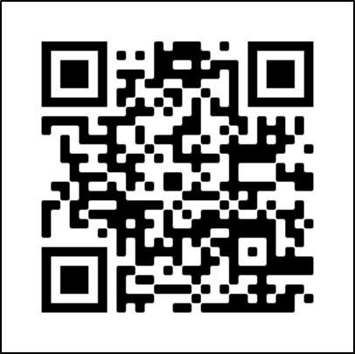
Join the ERWC online community!
writing.csusuccess.org/community/register
There you can find:
•ERWC curriculum (mini-modules,
portfolio modules, full-length, & ELD modules)
•Overview documents
•Discussion boards
Next Level Professional Learning Resources
https://writing.csusuccess.org/
If you already have an account, go to writing.csusuccess.org

Slide 53

Reflecting on the introductory session
Look back on your learning goals from earlier. What progress did you make toward those goals today and what are next steps?
How prepared do you feel about sharing information about ERWC?
Notes:
If you use a feedback form, consider providing it electronically with a link and a QR code so participants can easily fill it out.

Slide 54

Notes:
See if anyone has questions.

Slide 55

www.calstate.edu
Notes:
The California State University
www.calstate.edu

