Slide 1


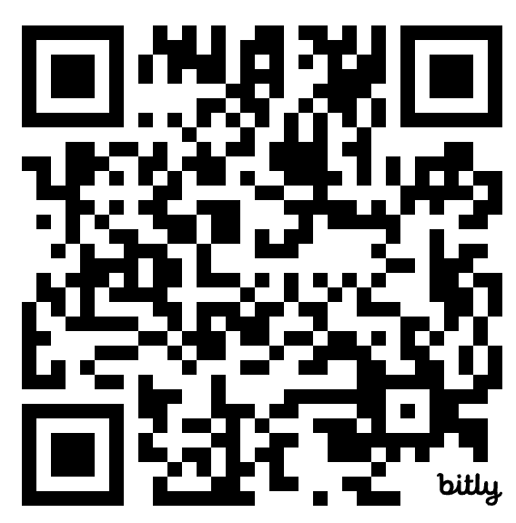
Found in Rhetoric
Leveraging Found Poetry to Assess Critical Thinking & Communication
Cassiopeia Guthrie
Distinguished Teacher in Residence
California State University, San Marcos
Notes:
In this session, attendees will engage in a project-based approach to assessment in which they become the learners. Through an immersive activity, attendees will engage with texts of their choice, generate rhetorical interpretations of their content, then apply their own personal thoughts and feelings about those subjects via poetry and art before engaging in a Poetry Read exhibition. In this hands-on workshop, attendees will investigate and discuss the application of found poetry and symbolic collages as assessment techniques which not only provides space for student agency, autonomy, creativity, and interactivity, but also allow learners to explore rhetorical concepts across multiple contexts.

Slide 2


Agenda
Stoke
Norms/Outcomes
Lesson
Text Choice
Rhetorical Interpretations
Application: Poetry Writing & Art
Poetry Read Exhibition
Debrief

Slide 3


Stoke
Everyone wanders around. When you hear the audio cue, stop to greet a partner according to the scenario on the screen.
Notes:
1| Your partner is a long-lost friend. 2| You’re 70% sure your partner is famous. 3| You shared an awkward first date last week with your partner. 4| Make up your own!

Slide 4
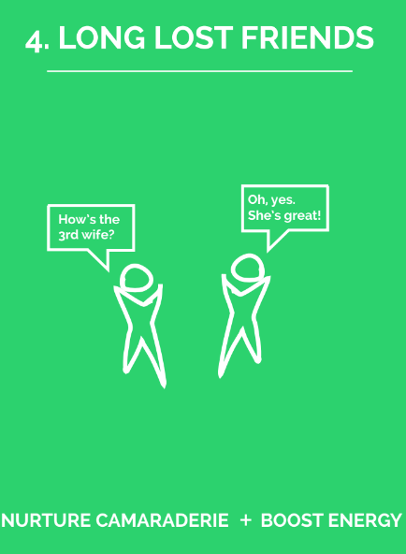
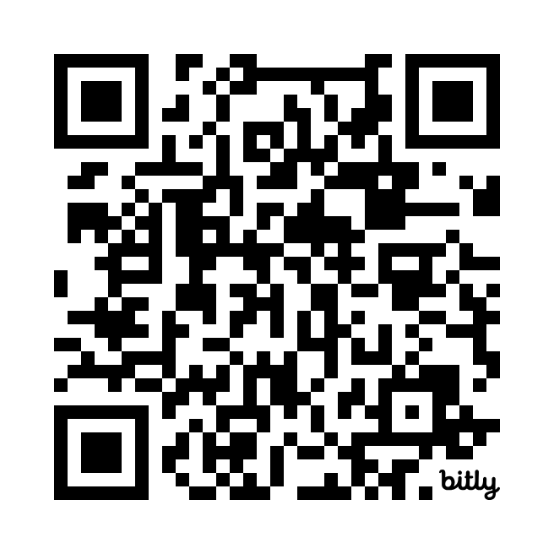
Your partner is a long-lost friend.
You’re 70% sure your partner is famous.
You shared an awkward first date last week with your partner.
Make up your own!

Slide 5

Norms
Outcomes
Celebrate learning
Seek to understand
Keep students at the center
Share your truth
Suspend judgment
Assume positive intent/acknowledge impact
Our ideas belong to the group
Today, we will:
generate rhetorical interpretations of self-selected texts, focusing on suasive diction and claims
apply rhetoric and suasive diction to create a Found Poem
participate in an exhibition of our work

Slide 6

1-2 Days
1-2 Days
2 Days
generate rhetorical interpretations of self-selected texts, focusing on suasive diction and claims
select rhetoric and suasive diction
use selected rhetoric and suasive diction to create a Found Poem
leverage upcycled materials into a collage which matches our intended rhetoric
exhibit work via a Poetry Reading or competition
explain, defend, and analyze to what extent a poem/collage effectively presents the intended rhetoric/ position on the topic selected

Slide 7
1-2 Days
1-2 Days
2 Days
generate rhetorical interpretations of self-selected texts, focusing on suasive diction and claims
select rhetoric and suasive diction
use selected rhetoric and suasive diction to create a Found Poem
leverage upcycled materials into a collage which matches our intended rhetoric
exhibit work via a Poetry Reading or competition
explain, defend, and analyze to what extent a poem/collage effectively presents the intended rhetoric/ position on the topic selected

Slide 8
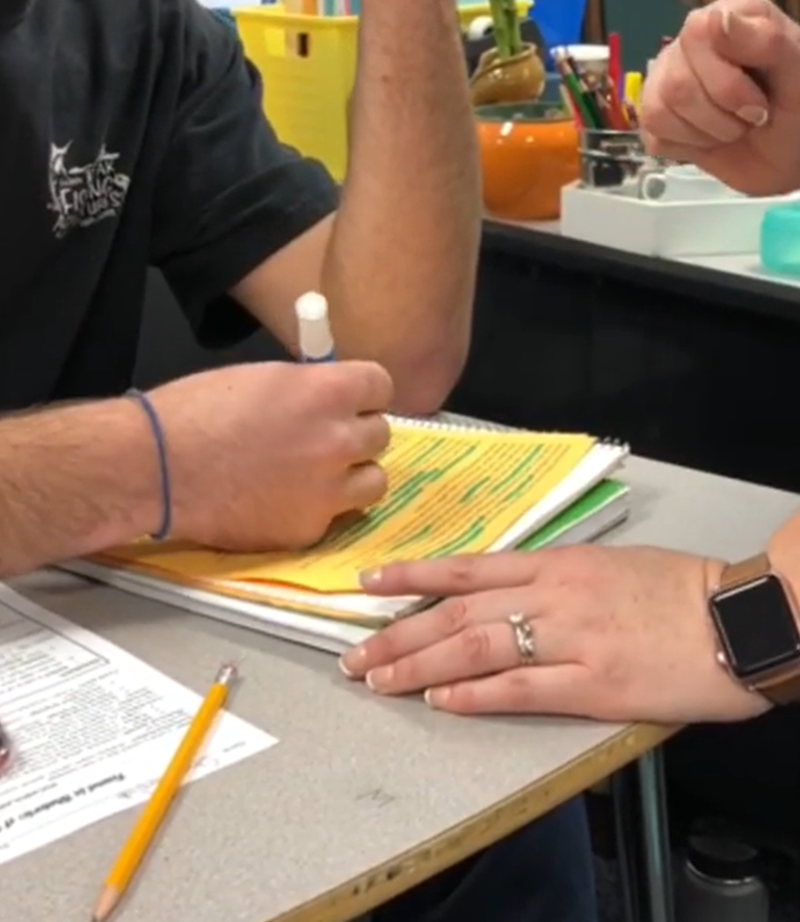
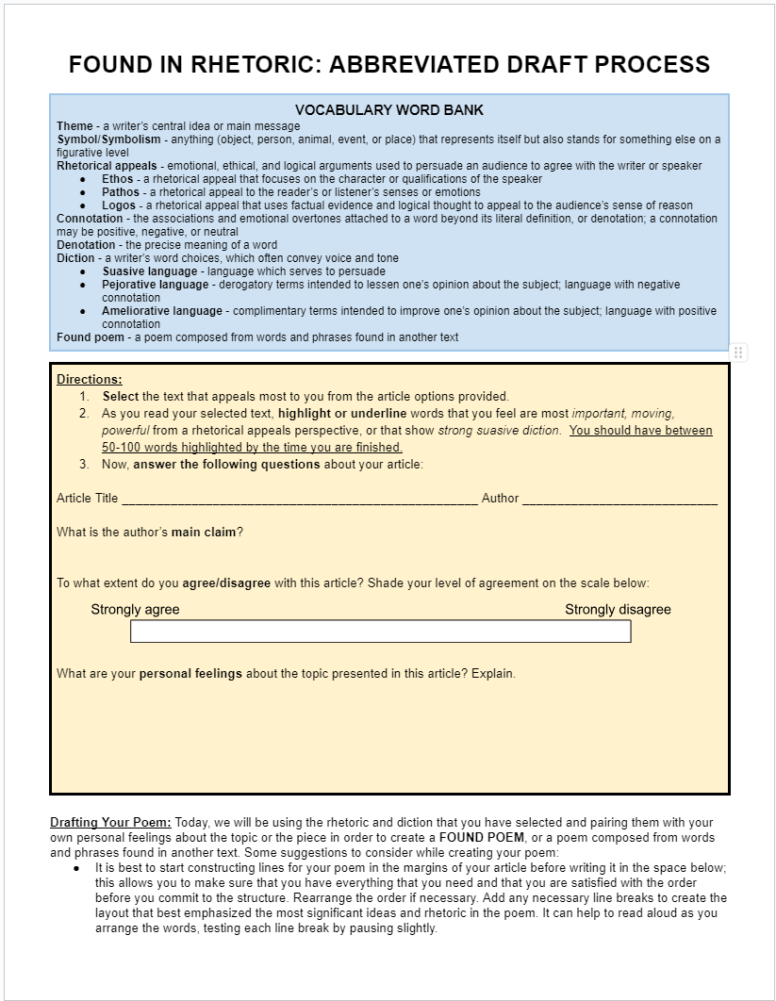
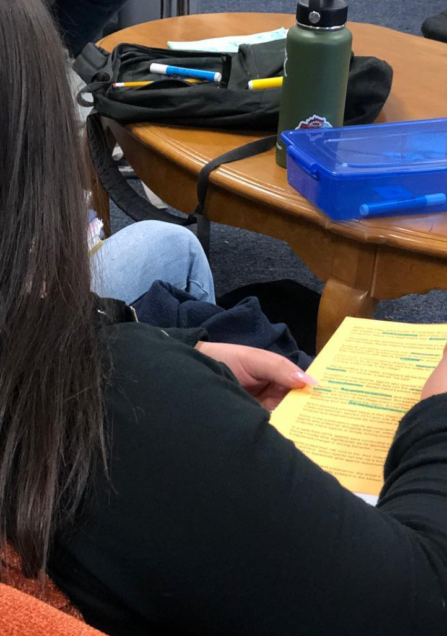

15 minutes
1-2 Days
Continue onto the reverse when ready!
generate rhetorical interpretations of self-selected texts, focusing on suasive diction and claims
select rhetoric and suasive diction

Slide 9
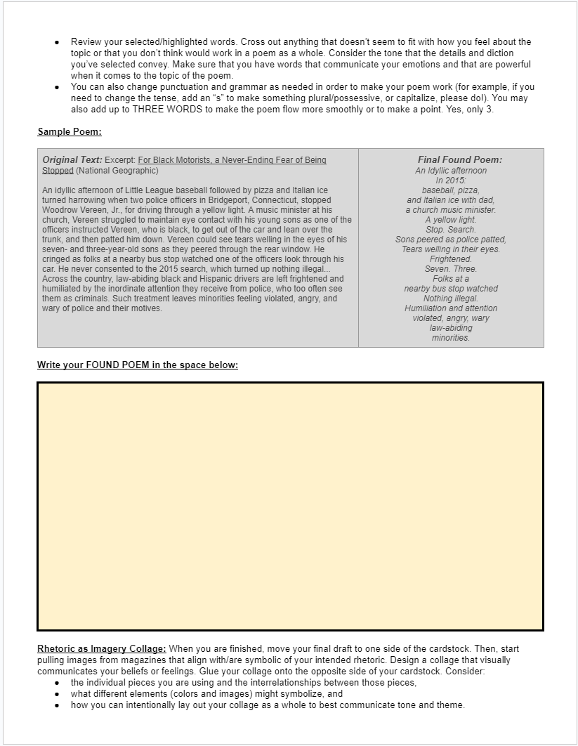
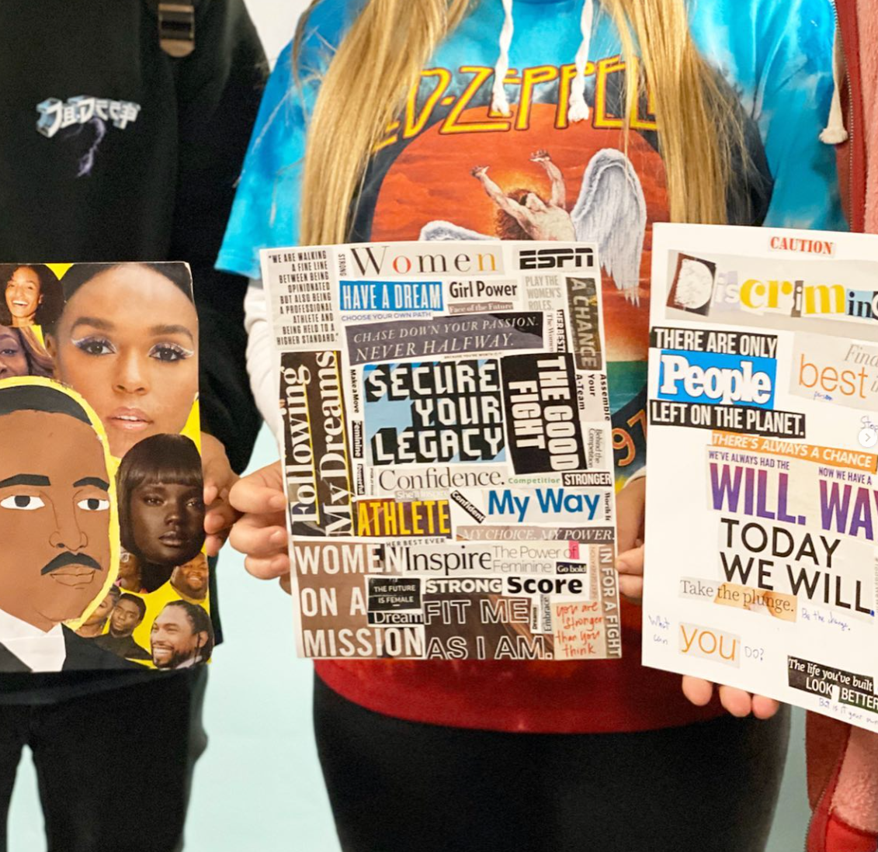

20 minutes
1-2 Days
as time allows!
use selected rhetoric and suasive diction to create a Found Poem
leverage upcycled materials into a collage which matches our intended rhetoric

Slide 10
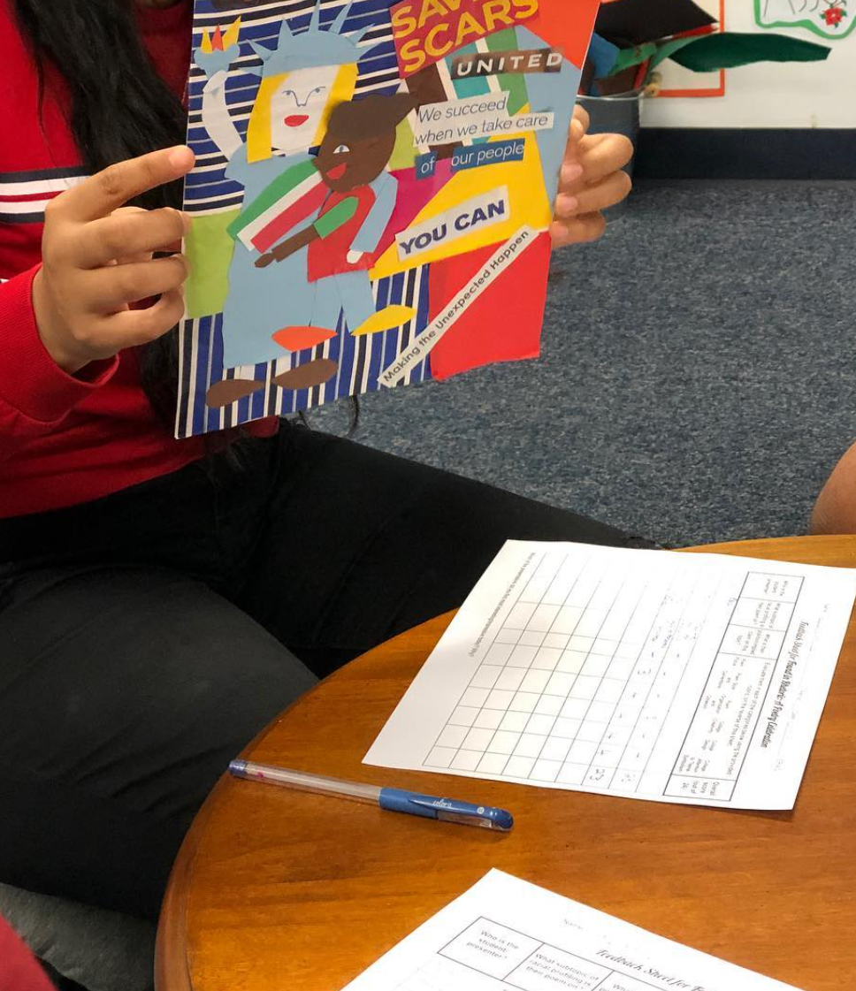
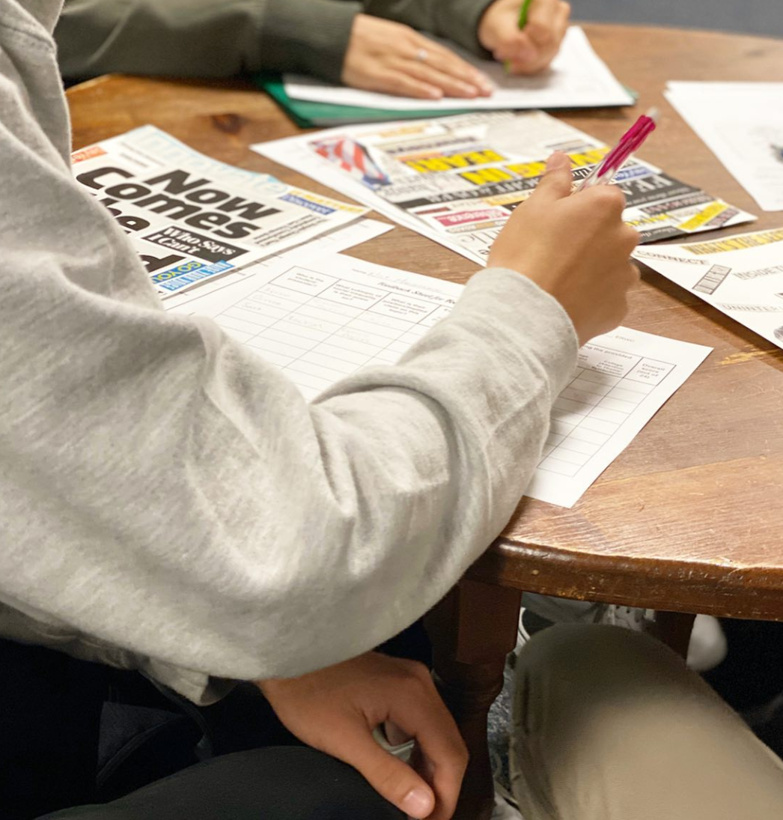

5 minutes
2 Days
exhibit work via a Poetry Reading or competition
explain, defend, and analyze to what extent a poem/collage effectively presents the intended rhetoric/ position on the topic selected

Slide 11

In class:
Use ERWC Template
Survey the Text
Read With the Grain
Read Against the Grain
Dialogic circles surrounding suasive diction

Slide 12

In class:
Workshop poems
Thematic and symbolic visual rhetoric lessons
Extended design process
Upcycled materials
Digital design

Slide 13
In class:
Presentations with feedback loops
Bracket-style Poetry Competition
Poetry Analysis Essay: Explain, defend, and analyze to what extent the poem and collage effectively presents the intended rhetoric/ position on the topic selected.

Slide 14

Let’s Talk it Out
What natural connections do you see with your instruction?
What extensions or connections might you make if you brought this project into your classroom?
What questions are remaining for you?
Notes:
1| Your partner is a long-lost friend. 2| You’re 70% sure your partner is famous. 3| You shared an awkward first date last week with your partner. 4| Make up your own!

Slide 15

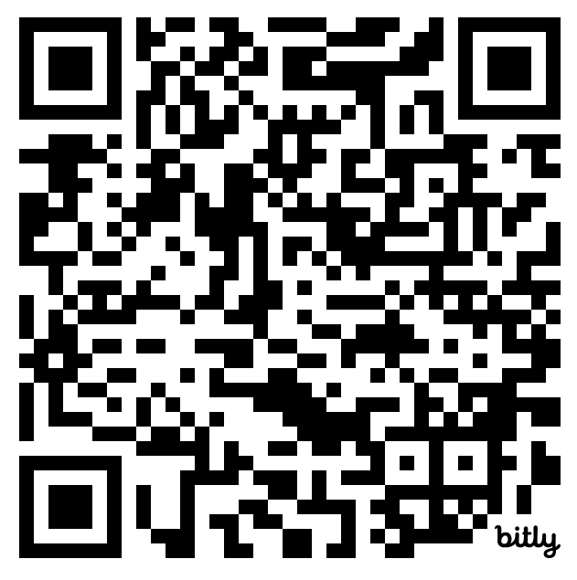
Thank you!
Resources:
bit.ly/foundinrhetoric
Cassiopeia Guthrie
@cassiopeiacomm

Slide 16
Session Description
In ERWC, students explore rhetorical concepts across contexts. Applying their learning to new real-life contexts of their choice is key; with this in mind, in this session, attendees will engage in a project-based process which creates an opportunity for them to generate their own rhetorical interpretations on a subject of their choice, then demonstrate their own personal thoughts and feelings about that subject via poetry and art.
Attendees will begin by evaluating an expository text of their choice from a facilitator-provided text set. The initial text set will vary based on area of study and should be curated to align with the interests of the students, but should represent multiple scales (global, regional, local) and perspectives (political, historical, cultural, economic, ecological). Attendees will read the text, evaluate the rhetoric within it (typically Survey the Text and Read with/against the Grain, but we will do an abbreviated version for time), and consider their own thoughts, opinions, and experiences related to the topic as they engage in restorative/content circles.
Identifying and leveraging suasive diction and rhetorical appeals within the text, attendees then generate a found poem which communicates their own feelings about the topic, creating a derivative piece of poetry that leverages the author’s words to convey a new intentional interpretation on behalf of the reader. The intent here is that attendees not only observe and make sense of the content within their selected article, but also communicate their own feelings and experiences through words.
Attendees continue by sourcing and curating symbols and images from magazines for collages that match the rhetoric of their poem, reinforcing their messaging itself as well as the ways in which rhetoric is used in visual communication. Finally, attendees will engage in a “poetry read” protocol with small groups, reading their poems, discussing the process, and exploring additional extensions and connections that could be explored within the unit.
This unit is rhetoric-focused, culturally sustaining, and empowers student audiences to action, while creating spaces for them to practice engaging in difficult conversations respectfully and to deepen their learning about each other empathetically.
Notes:
1| Your partner is a long-lost friend. 2| You’re 70% sure your partner is famous. 3| You shared an awkward first date last week with your partner. 4| Make up your own!

