Slide 1
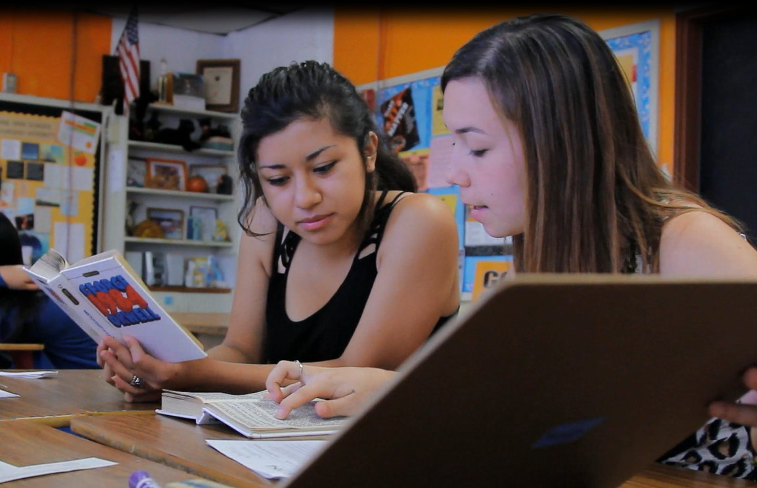
ERWC and EAP and County office leads: Partnerships
Session 3 Leadership Conference
Summer 2024

Slide 2
Welcomes

Slide 3
Ice breaker: What is College and Career readiness –Survey and discussion (10 Min)
QR code for a survey (https://docs.google.com/forms/d/1khlxMpOoCg8bzdf7_VzHpwRpGFxxHtytUM_VZf3KXhA/edit?ts=6668db8c) to give to the EAP directors with these questions and a few others:
How do you define and operationalize “college readiness”? Career Readiness?

Slide 4
Shared interest: ERWC
How do we support ENGLISH and ERWC specifically? In what ways and to what extent do we each support English in our state? Each region does it differently…what do you do? How is that going?

Slide 5
Panel Q and A with Partners
Panelists: Stephanie and Kia and Chris Eddings (how county does it?)/Lisa Benham (both), Zee. Marcy, and Faye (south)
Possible topics:
1. Process and policies:
Reimbursements-who do we go to to get paid? How does this happen? Details on how to do it? Process…. Faculty trainers MUST submit scope of work….Adjunct faculty?
What happens when a county office or EAP says no sessions are taking place?
Where do people send new teachers to ERWC to be trained? How much are we offering online ERWC sessions VS f2f? Should we offer more online for other places that are in need? Do we accept teachers from other states? (workshop attendees should be ok from New Mexico, Hawaii, West Virginia, and Washington.)

Slide 6
Panel Q and A with Partners
Panelists: Stephanie and Kia and Chris Eddings (how county does it?)/Lisa Benham (both), Zee. Marcy, and Faye (south)
Possible topics:
1. Process and policies:
For EIR grant, what shall we do with those people signing up from other states?
Middle school teachers and trainings they can attend? (currently they can attend hs trainings). In the future, we will train middle school teachers….support them….but how is what we have not determined.
Private, public? Which teachers and faculty can attend these sessions? (DISCUSS POLICIES)—Make up session policies (can a person who misses a day make it up somewhere/some way?—how can we guarantee they align with the sessions they already registered for? (DISCUSS policy of HOW TO communicate responsibilities for that make up)

Slide 7
Panel Q and A with Partners
Panelists: Stephanie and Kia and Chris Eddings (how county does it?)/Lisa Benham (both), Zee. Marcy, and Faye (south)
Possible topics:
1. Process and policies:
Will trainers remain 2 (faculty and teacher, and in what circumstances can there be 3?
Contracts for MOUs.—held up due to budget uncertainties.
Process for workshops (new link): to register and to get canvas site. BUDGET is holding this up. Some campuses have no travel policy,,,,

Slide 8
Others?

Slide 9

IMPLICATIONS and moving forward

Slide 10


Slide 11

ISSUES and CONCERNS

