Slide 1

Bridging the Gap: Utilizing Threshold Concepts to Enhance Language Acquisition and Content Learning for English Learners
Hector Raul Yerena Jr / ELA & ELD Educator

Slide 2

Introduction
Name: Hector Raul Yerena Jr
Position: 3rd year educator, formerly teaching ELA & ELD over at Gustine Middle School
Experience:
Standard ELA
Honors ELA
(Recently: Dual Teaching ELA & ELD for 7th & 8th grade)

Slide 3
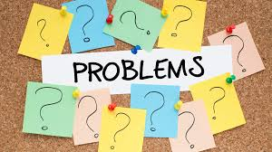
Food for Thought: Inquiry #1
What is the biggest struggle you felt that you have faced in your life? (Academic, Personal, etc.)

Slide 4
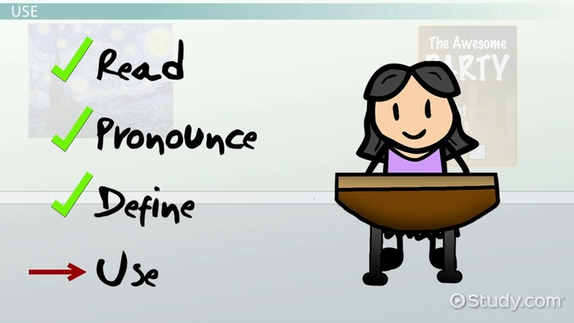
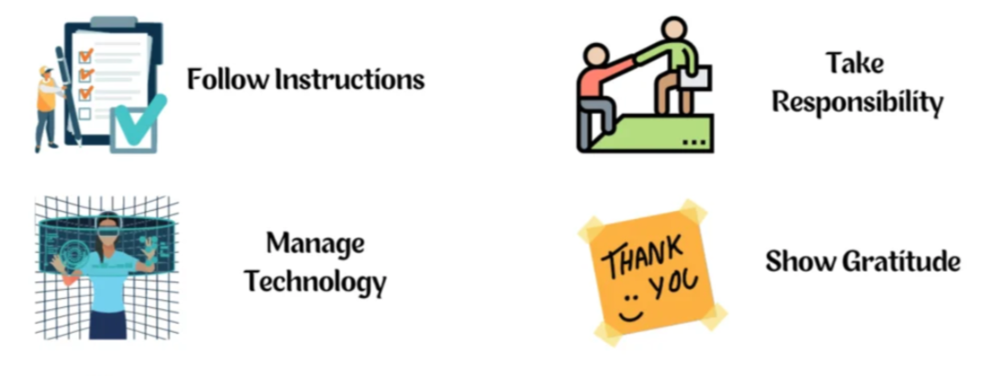
The Dual Challenge for English Learners (Linguistic Demands)
01
02
Linguistic: Vocab Acquisition
Building student terminology is paramount. Many of our students face the hurdle of learning technical terms.
Linguistic: Cultural Nuances
In the medium of English, things such as social norms, expression, and etiquette is another demand students need to learn

Slide 5

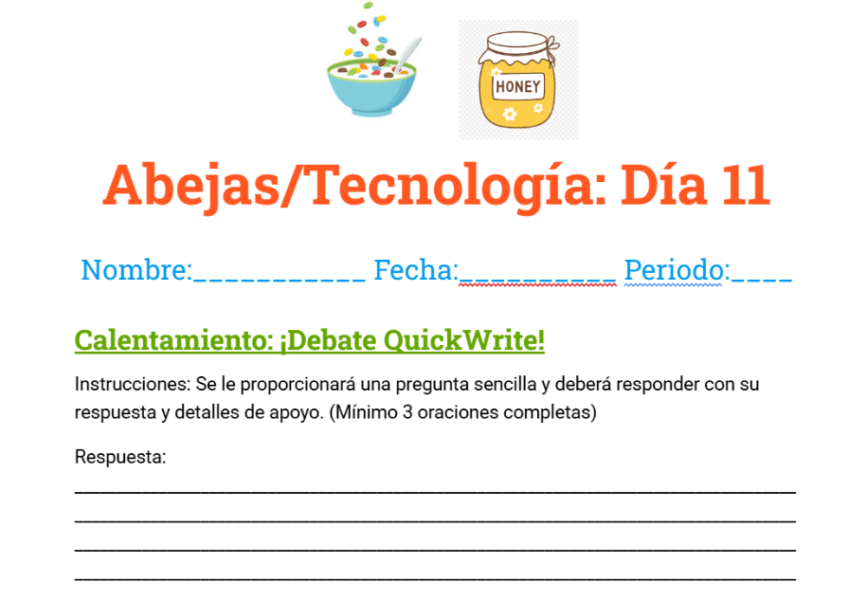
The Dual Challenge for English Learners (Unique Cognitive Demands)
01
02
Cognitive: Strategic Learning
Note-Taking, Summarizing, and translated materials.
Cognitive: Information Processing
Aspects such as directions and comprehending material require additional attention to assist our students.

Slide 6

Food for Thought: Inquiry #2
How often do our EL students seem to “get it” (i.e. A skill, Material, etc.) but then struggle to apply it?

Slide 7

What are Threshold Concepts?
Threshold concepts are fundamental ideas within a discipline that, once grasped, transform a student's understanding and allow them to progress in that field.
To simply put, think of a threshold concept kind of like an “aha” moment!
If for example, a child learns how to ride a bike, that it itself is a threshold concept.
They may struggle at the start, but over time with practice and strategies, the “aha” moment will reach them, and transform how they progress in life!

Slide 8
Threshold Concepts: relevance for our ELs
Struggles
Often where ELs stumble due to linguistic barriers, conceptual complexity, or something else!
Integrative
By understanding our students’ struggles, we can help them succeed with threshold concepts!
4 main points
Focus point
Provide a strategic focal point, rather than just covering content
Irreversible
Once understood, they become part of an EL's new intellectual landscape.

Slide 9
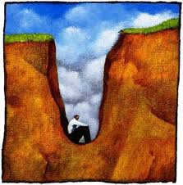
Food for Thought: Inquiry #3
Think of a “stuck place” your student(s) may face in your subject (i.e. student struggling to take effectives notes)
What concepts, if truly understood, would unlock significant progress in helping students overcome their “Stuck place”?

Slide 10
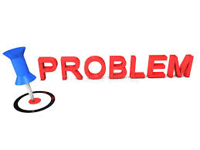
Main Point #1: The struggles/thresholds our students have, and how to pinpoint them
Our struggles our students go through in every subject will vary (i.e. teaching the “Main Idea” in ELA, teaching “cause and effect” in History/Science, etc.)
But we know the two big struggles most of our EL students go through is Linguistic Demands (Barriers) & Conceptual Complexity (ideas that may come off as intricate)
Fortunately, there are ways to pinpoint these struggles to identify these thresholds to help our students:
Our students relying on “Rote Learning” (memorizing info or procedures, but not grasping definitive comprehension)
Limited participation; withdrawing from various levels of discourse or showing lack of confidence.

Slide 11

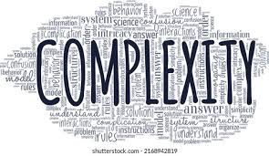
Main Points #2 & #3 - Integrative/Focus Point: Bridging the gap with accessibility!
Linguistic Demands - We can bridge this gap by:
Discourse Markers and sentence frames
Providing students with appropriate methods to help kickstart wants to say gives them a foundation on how they want to structure their response
Translated materials (in our students’ appropriate native language; then build off to English over time)
Conceptual Complexity - We can bridge this gap by:
Collaborative cooperation
Having students work with different students to share different ideas can bring comfortability and enhanced expression of ideas, which can help with comprehension
Chunking w/ low stakes practice!
Providing opportunities for our students with simple bits of information can help relieve fear of failure and refine material comprehension

Slide 12
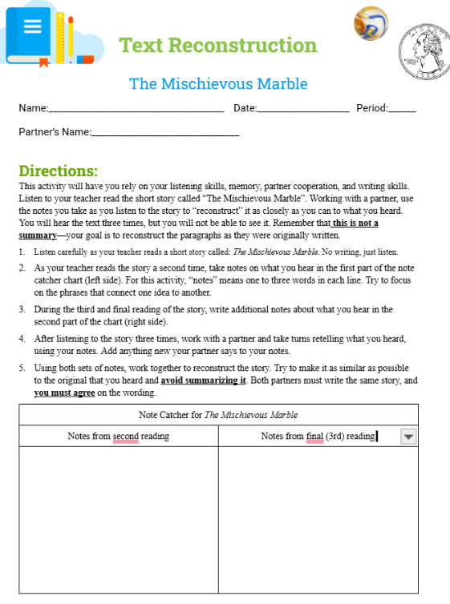
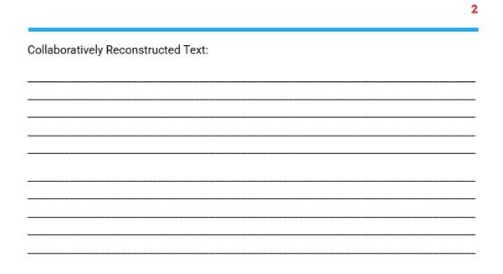
Main Point #4: Irreversible! (Anecdotal experience)
Activity: Text reconstruction for 7th & 8th grade ELD
How does it “bridge the gap”?:
The instructions are chunked and broken down verbally by their instructor, and students are allowed to work with peers!
Low stakes, accessible, and versatile!
Students are read a very brief story to them (1-2 paragraphs) 3 times total, take down notes, and attempt to rewrite the story from memory!
This is an activity that can be modified for different stories, units, and can be repeated for practice/review!

Slide 13
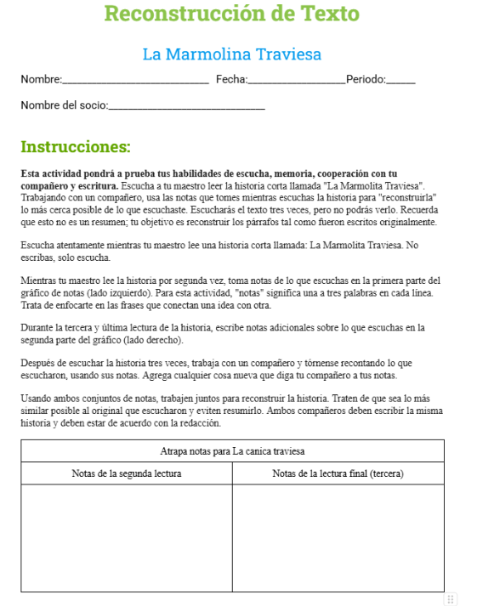
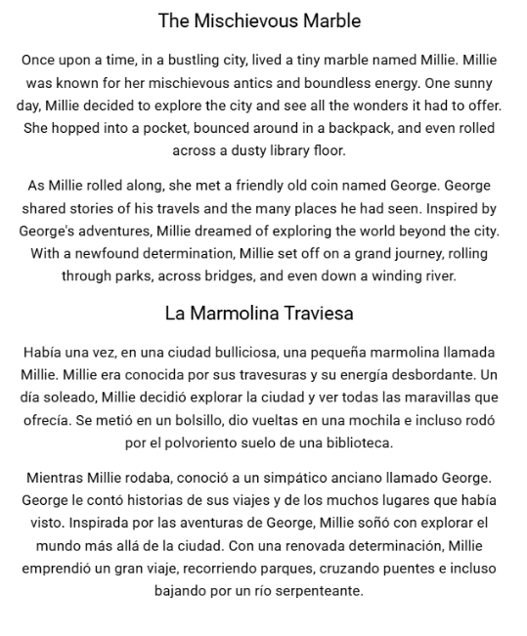
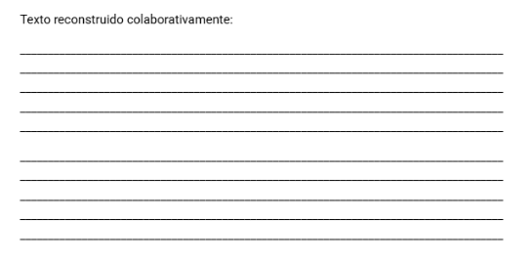
Main Point #4: (Anecdotal experience con’t)
Continuing to bridge the gap:
This language helps with linguistic demands with their “note catcher” chart, informing students on what kind of notes they should write down (words, phrases, or sentences)!
Translated material(s):
The stories read to the students for this kind of activity is provided to them in not just English, but also their designated language to help them with comprehending the material!
Over time, with repetitive use of this activity, students have shown improvement in their intellectual landscape with mastered irreversible threshold concepts in comprehending skills and materials!
(Activity is provided to them and read in their designated language as well!)

Slide 14

Food for Thought: Final Inquiry
As we aim to bridge the gap for our ELs, what's one key takeaway about integrating language and content learning through threshold concepts that resonates most with you, and how might you share this insight with a colleague?

Slide 15


Conclusion: Main Takeaways and Questions?
Threshold concepts are defined as fundamental ideas within a discipline that, once grasped, transform a student's understanding and enable them to progress in that field
The dual challenges our EL students face are linguistic and cognitive demands
In addition to the dual challenges, we also have 4 main points in relevance to threshold concepts:
Student struggles
Integrative comprehension
Establishing a focal point
Irreversible progress
With viable threshold concepts correlated with language integration & concept learning, it can help effectively bridge the gap our students face in their learning endeavors!
Any final questions?

Slide 16
Works Cited
Thank you!
Meyer, Jan H. F., Ray Land, and Caroline Baillie, eds. Threshold Concepts and Transformational Learning. Sense Publishers, 2010.
Olaniyi, Nkaepe E. E. “Threshold Concepts: Designing a Format for the Flipped Classroom as an Active Learning Technique for Crossing the Threshold - Research and Practice in Technology Enhanced Learning.” SpringerOpen, Springer Singapore, 29 Jan. 2020,
Snyder, Christine. “ERWC Curriculum: Living Beyond Borders Module .” Living Beyond Border: Module - Teacher Version, 2023.

