Slide 1
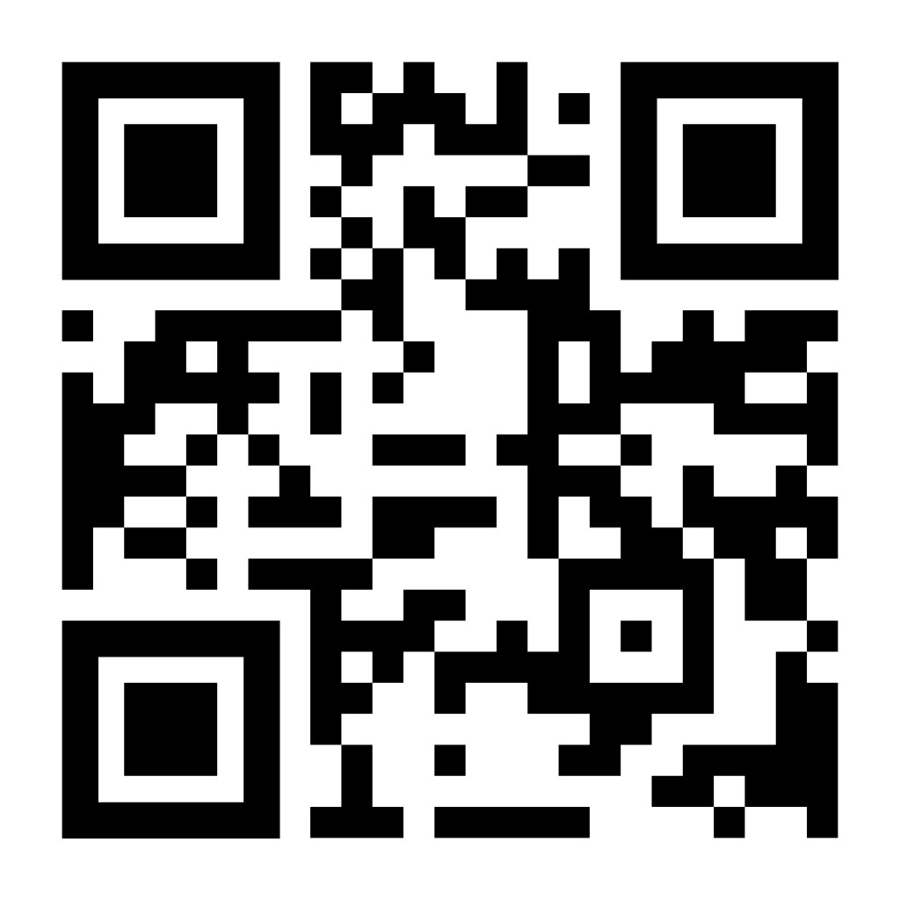
Re-thinking Relevance: Adapting ERWC to meet the needs of rural students
Dr. Andrea Cota
Foothill High School
Shasta Union High School District

Slide 2
ME
Starting my 20th year as a classroom teacher in 2025-2026
Began my career in the high desert above LA, and spent 10 years in both public and charter schools in LA, Orange, and Riverside counties. In 2016 I relocated to Redding, CA and have been with Shasta Union for nearly 10 years.
I’ve taught ERWC for almost 15 years, participated WestEd study on ERWC, and teach dual enrollment for seniors.
District Department Chair for English
This year, I worked with juniors for the first time in years, using ERWC modules and strategies throughout the course.

Slide 3
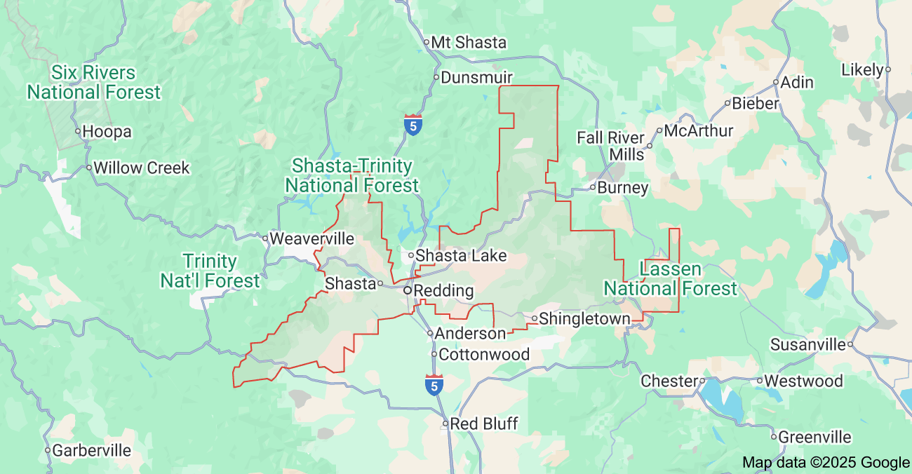
My Community
Far Northern California
Shasta County, population 180,000 over 3,847 square miles
2 hours from the Oregon border and 2.5 hours from Sacramento
Serve a huge geographic area covering 1891 square miles.
Notes:
https://www.census.gov/quickfacts/fact/table/shastacountycalifornia/PST045224

Slide 4
College attendance in Shasta County
We have a high graduation rate of 87.3 county-wide--Shasta Union nears 95%
College rates: 23% of Shasta County has a bachelor’s degree compared with 34% statewide
Rural communities typically have lower A-G completion rates compared to Urban counterparts.
45% of graduates enroll at Shasta College
Transfer rates are low, which is typical of rural communities, some sources suggest it is as low as 8% (2021 most recent data)
Notes:
https://edsource.org/2019/interactive-map-the-path-from-california-community-colleges-to-bachelors-degrees/621241
https://calmatters.org/education/higher-education/2023/07/community-college-transfer/
https://www.calpassplus.org/LaunchBoard/Student-Success-Metrics.aspx

Slide 5
Highest rate of suicide of any CA county.
25% of children live at or below the poverty line
According to Youth Partnership “53.2% of children in SC had an at least one ACE compared to 36.2% overall CA”
Notes:
https://www.shastacounty.gov/media/13571
https://www.shastacounty.gov/health-human-services/page/pr-you-matter-shasta-offers-free-self-study-suicide-prevention-trainings#:~:text=These%20trainings%20aim%20to%20address,10.3%20suicides%20per%20100%2C000%20people.
https://californiayouthpartnership.org/local-data

Slide 6
My School--Foothill High School, Palo Cedro
Foothill High School
71.6 % white
14.5 % Hispanic Latino
3.6% American Indian or Alaska Native
4.7% identify as more than one race
1432 students (and growing)
45.5% Socio-economically disadvantaged
My School District
Union with 3 comp sites, 1 alt site)
64% White
16.7% Hispanic/Latino
3.9% American Indian Alaska Native
5.1% identify as more than one race
4215 students (declining enrollment)
54.5% Socio-economically disadvantaged
Notes:
https://dq.cde.ca.gov/dataquest/dqcensus/enrethlevels.aspx?agglevel=School&year=2023-24&cds=45701364530044
California dashboard
Califnorn

Slide 7
So Why ERWC?
We adopted ERWC as our senior curriculum in the early 2010s.
Most of us teach multiple ERWC units each year. Our county is the regional lead for ERWC.
High collaborative department
aligned by texts and units--some common assessments
strong PLCs
I used the ARC or established ERWC modules and materials to frame nearly every unit I taught with my juniors.
As an 11th grade team we typically read:
The Great Gatsby
The Crucible
The Things They Carried
Teachers often do at least one unit of choice.
I chose Jeff Zenter’s The Serpent King

Slide 8
Adapting ERWC

Slide 9
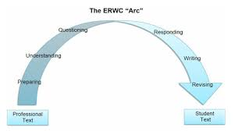
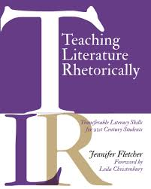
Developing the unit
My Resources
The arc was my friend
Strategies book helped
Experience with other units
Notes:
https://www.google.com/imgres?q=ERWC%20ARc&imgurl=https%3A%2F%2Ferwc.blog%2Fwp-content%2Fuploads%2F2022%2F04%2Fscreen-shot-2022-04-02-at-9.21.39-am.png%3Fw%3D1024&imgrefurl=https%3A%2F%2Ferwc.blog%2F2022%2F04%2F28%2Farcs-and-spirals%2F&docid=5_NVU9GzF9d1xM&tbnid=d-0V7lB4Lpcd7M&vet=12ahUKEwiTz_ORqNONAxUNNzQIHVVpM9sQM3oECBgQAA..i&w=1023&h=571&hcb=2&ved=2ahUKEwiTz_ORqNONAxUNNzQIHVVpM9sQM3oECBgQAA

Slide 10
Gathering Sources for The Serpent King
Limited built resources
One Academic study from English Education (April 2022)
Reading The Serpent King to Connect to Students' Lives and Experiences in Rural Contexts
Best practices take over…

Slide 11
The Culminating Task comes first

Slide 12
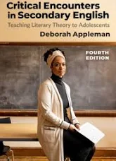
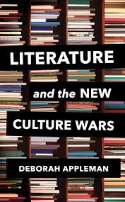
Develop the Culminating task first
Backward Design and my first roadblock…
Original plan: Use the book as a way to enter into research about rural issues and write a research paper.
What really happened…
Reader Response Theory
Readers response Essay with Two micro-writes on effective Summary and Structure.
Followed by a unit on inquiry that lead to a research project, but that’s another story…

Slide 13
The ARC:
Preparing

Slide 14
Context Mattered

Slide 15
Getting Reading to Read--setting them up for success
I build activities using the tools at my disposal--especially other ERWC literature units.
Quickwrites
Key Terms
Key Concepts
Vocabulary
Creating Personal Learning Goals*

Slide 16
Example Activity: Exploring Key Concepts: My Town
In your notebook, create a two-column chart. Label the first column Positive Attributes; label the second column Negative Attributes. Think about the city or town where you live. List all the positive attributes about your city or town in the first column. Then list all the negative attributes in the second column. Share your chart with another person in class. Together with a classmate, brainstorm ways to improve the negative attributes.
Positive Attributes | Negative Attributes

Slide 17
The ARC:
Understanding
Questioning

Slide 18
Breaking the text into sections To Understand and Question
Making predictions and asking questions
Annotating and Questioning the Text
Examining Structure
Thinking Critically
Summarizing and Responding.
Descriptive Plot Outlining
Levels of questioning
For each section, I worked to have these types of activities designed.
Because the text was extremely accessible for my students, we spend more time discussing the “big picture” ideas, used a combination of discussion questions designed to target the structure of the text and author “moves”.
We examine the structure of the text, focusing on plot and point of view.
I also worked to incorporate reader response questions as we summarized and responded to the text.

Slide 19
Examining structure Example
Chapter 6
Are there any similarities between these three characters and their home lives? Why do you think they are friends when they all come from such different backgrounds?
Dill’s home life
Make a prediction about Lydia’s future,.
Lydia’s Home life
Travis’s home life
Zentner uses a particular way of organizing the text. Examine Chapters 4-6 What do we learn about each character’s home life from these chapters?

Slide 20
Thinking Critically Example
Examine how the plot shapes these conflicts.
How do the characters change as a result of the conflicts they encounter?
Conflicts
Dill vs.
Travis vs. his father
Lydia vs.
His guilt, and fear of the future
His Mom and dad
His community, church and social reputation
Society, both Forrestville and the greater world
Dill

Slide 21
Summarizing and Responding example
Consider your own relationship with your parents or guardians. When do you need to “break away” and live your own life? Will you? Can you?
Do you think Dill and his mother will resolve their differences?
Dill’s dad says “You are abandoning us by choice, the way your grandfather abandoned me.” Is that a fair comparison?
Do you believe Dill’s father when he said he did not abandon them by choice?
What do you think of the end of the book? Are you satisfied as a reader?

Slide 22
Responding
Writing
Revising

Slide 23
Reading and thinking Rhetorically
Shifting the way I thought about literature
Using a rhetorical lens
Using tools typically used for argument writing and applying them to literature.
Examining “author moves” as a way to understand “why” they wrote certain ways.
Examining structure as a way to enter into a conversation about function, purpose, and message.

Slide 24
Summarizing and Structure
“Micro-Writes” responses that are less than a paper, usually focused on a particular element of writing.
Department wide use of rhetorical “precis” model for summarizing both with fiction and non-fiction texts.
Non-Fiction | Fiction
Credential sentence Main argument/support Purpose Tone/Audience Significance to the topic | Credential sentence with a theme statement Brief summary: main characters, setting, and plot Structure of the text Purpose Literary device used to achieve the purpose

Slide 25
Examining Structure
More challenging to explain that I thought.
Flipped the order (structure first, precis second)...good idea…not sure…
Do-Over: helping link the paragraph to the precis.
Created a unintentional “backwards map” that worked, but needs revision
And that’s a big lesson…

Slide 26
Ask them to reflect, but I needed to as well…
What I started out with changed as I taught the unit for good or bad.
What would I change now…
Upping my expectations for them to read at home--it took too long. It would create the time to…
Refine the personal response and dig into reader response theory more intentionally in discussion with them.
Focus on the big questions at issue more intentionally.
Be less afraid to try it again with a different book…

Slide 27
My learning and advice
Examining rigor and accessibility of the text
My comfort with the content
Time management and student expectations
Teaching to the group that’s in front of me
Considering the placement of an accessible book with tough topics
And there are successes…
Student growth of the CAASSP

Slide 28
acota@suhsd.net
Andrea Cota, Ed.D
Shasta Union High School District

