Slide 1
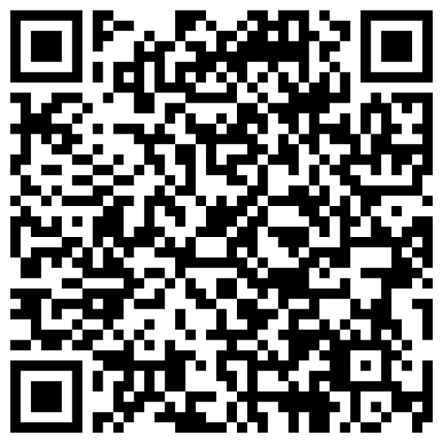
Opening the Gateway: Leveraging Digital Compositions to Develop Critical Thinkers and Writers
Tamara A. Rodriguez-Kam, M.A.
Buena Park High School
Twitter: @LitTeacherTam
Insta:
@trodriguezkam
Notes:
Annotation is a way to interact/dialogue with a text.
Who taught us how to annotate?/How did you learn how to annotate a text?
Today we have a generation of non readers
Annotation is not a test, it does not hurt anyone to work together...in fact that may be how we further develop as readers
Engage with the text and engage with each other.

Slide 3
Presentation Link: http://tinyurl.com/4tyz4p2y
PipNY
Session Overview:
Goals
  Participants will learn how to introduce and structure digital compositions and how to use those compositions to transition students into academic content and writing across the domains.
  Participants will also learn how to utilize digital compositions for cross-curricular performance tasks, increasing student transfer of knowledge.
About the Presenter:
  Tamara Rodriguez-Kam, M.A. Buena Park High, CSUF
    ELA Department Chair, AVID Site Coordinator
    AP Reading, English Literature and Composition, Assistant Chief Reader
    College Board Endorsed Consultant, English Literature and Composition
Keep in touch and follow me!
  trodriguezkam@fjuhsd.org, trodkam72@aol.com
  Instagram: @trodriguezkam
  Twitter: @LitTeacherTam

Slide 4
Agenda
Introductory Activity: “The Wedding Dress”
  Practice and Create a Sample
Focusing the Process for the ELA Classroom
  What types of writing do I cover in my classroom?
Extending to Writing
  How can I move from one medium to another?
Analysis, Reflection, Extension: How can this be used in my classroom?
  What are some ways I can use this going forward in my classroom?

Slide 5
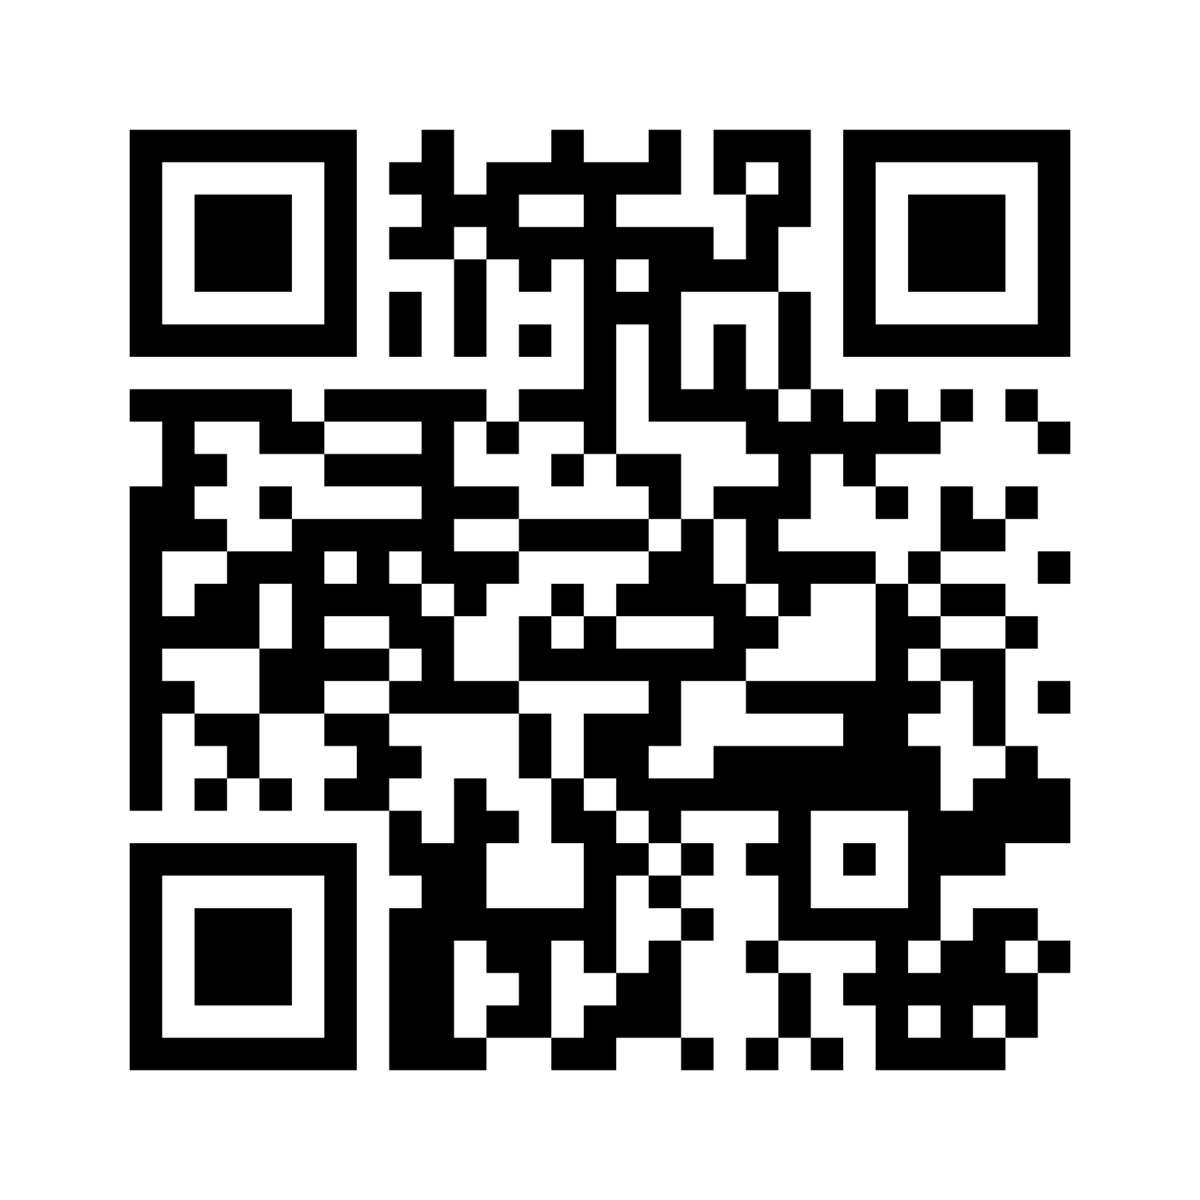
Talk to Your Tablemates: Tech Survey!
Click this LINK to complete our opening survey! Mentimeter Link
  In your spaces, find an elbow partner and talk a little about:
    Your responses
    Your thoughts
Reflect: Our students are digital natives and were digital learners through the pandemic, how has this impacted their learning?
  You can consider:
    Skill Set
    Social-Emotional Growth
    Technological Skill
    Etc!

Slide 6
Background and Framework
CCSS necessitates that students:
  Produce clear and coherent writing in which the development, organization, and style are appropriate to task, purpose, and audience.
  Develop and strengthen writing as needed by planning, revising, editing, rewriting, or trying a new approach, focusing on addressing what is most significant for a specific purpose and audience
  Use technology, including the Internet, to produce, publish, and update individual or shared writing products in response to ongoing feedback, including new arguments or information.
Thoughts from Jean M. Twenge, iGen: Why Today's Super-Connected Kids Are Growing Up Less Rebellious, More Tolerant, Less Happy--and Completely Unprepared for Adulthood--and What That Means for the Rest of Us
  “We have the most complete and instant access to information in all of history, and we’re using it to watch funny cat videos.” (Let’s leverage it for good!)
  “many iGen students seem to see their schools as behind the times, irrelevant in a fast-paced world of constantly changing technology.” (meet them where they are)
Notes:
70/30: all teachers should be reading and writing in classes, but may not feel comfortable doing so.
Students can learn to take the strategies that work for them and use them in other classes
Also mention the cultural breakdown, free and reduced lunch and freshmen reading 4th grade and below (over 80%) and high ELL population.

Slide 7
Methods and Materials!
How We Get Started!
  Students use digital composition in several ways (TikTok, Capcut, Insta):
    Narrative (tell a story, share a memoir, etc.)
    Inform (youtube, tiktok, etc.)
    Persuade/Argue (why we should try something, do something, etc.)
  These are the same things we do in writing:
    We have a controlling idea
    We have evidence
    We use words, images, music, etc. to help illustrate/convince the audience of our controlling idea
  Reframe both our perception and ideology as well as the students:
    If we can do this in one medium, we can transfer that knowledge to the other!
    The moves that students make so seamlessly in the digital world DO translate to writing!
    Be ready to NOT be the smartest person in the room here! (It’s a good thing!)
Notes:
Essential Question: Remember that they may read the same text with different objectives: IVF Article: Morality and Brave New World Connection (ELA), Biology: statistics and risks, etc. Gatsby: SS: Roaring 20’s, ELA: Symbolism of the color white
Giving them the initial questions helps them narrow...they can add other ideas and questions, but now they’re also a bit prepared for you.
House: Read and annotate; read and annotate as a real estate agent; read and annotate as a cat burglar. debrief/reflect. Reading with a purpose: connect to the idea that I was never explicitly taught to annotate, and I struggled...students are a generation of non readers (iGen), they have less frame of reference. Hence the need to help them focus

Slide 8
Getting Everything Set Up!
Introduce the Idea: Link to "Wedding Dress Digital Composition Directions"
Anchor Charts
  Lay out that we will need to count on each other to be successful and learn.
  Create a set of Anchor Charts
    Chart Paper: each with a different skill at the top (You could use Anchor Chart Slides)
      Uploading Pictures from a Phone to Google Drive
      Uploading/Importing Sound to a Video
      iMovie Help
      Recording a Screencastify
      Capcut
      TikTok
      Using Flip a Clip
      Whatever Help May Be Needed
    Have the kids put their names on the Anchor Charts for what they can help each other with.
  Post the Anchor Charts in the Classroom

Slide 9
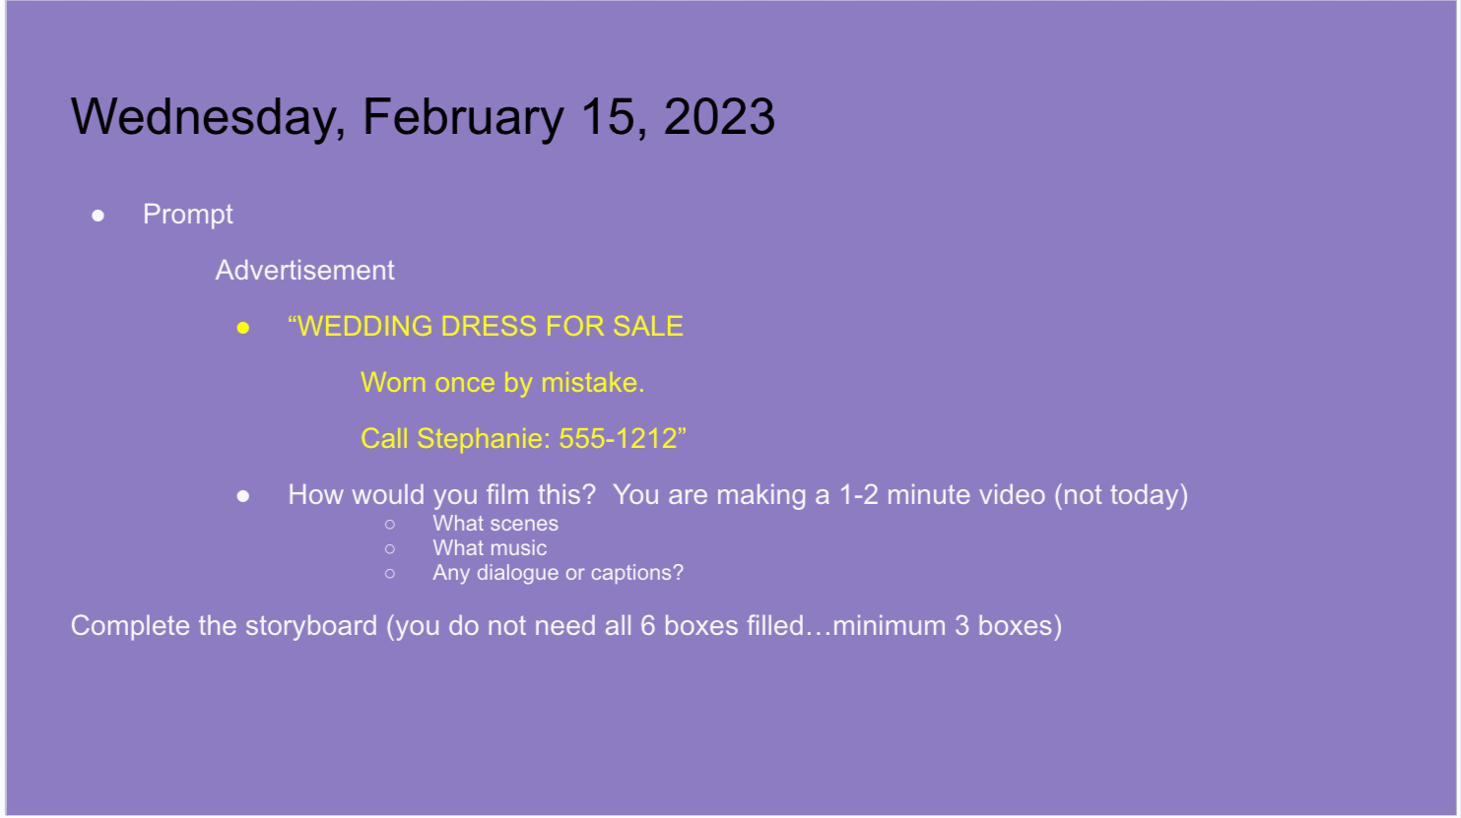
Getting Everyone Started!
“The Wedding Dress”
  Link to "Wedding Dress Digital Composition Directions"
Have the students work together on the next part!
  Gradual Release: Groups at first, then move to independence

Slide 10
Wednesday, February 15, 2023
Prompt
Advertisement
“WEDDING DRESS FOR SALE
Worn once by mistake.
Call Stephanie: 555-1212”
How would you film this? You are making a 1-2 minute video (not today)
  What scenes
  What music
  Any dialogue or captions?
Complete the storyboard (you do not need all 6 boxes filled…minimum 3 boxes)

Slide 11
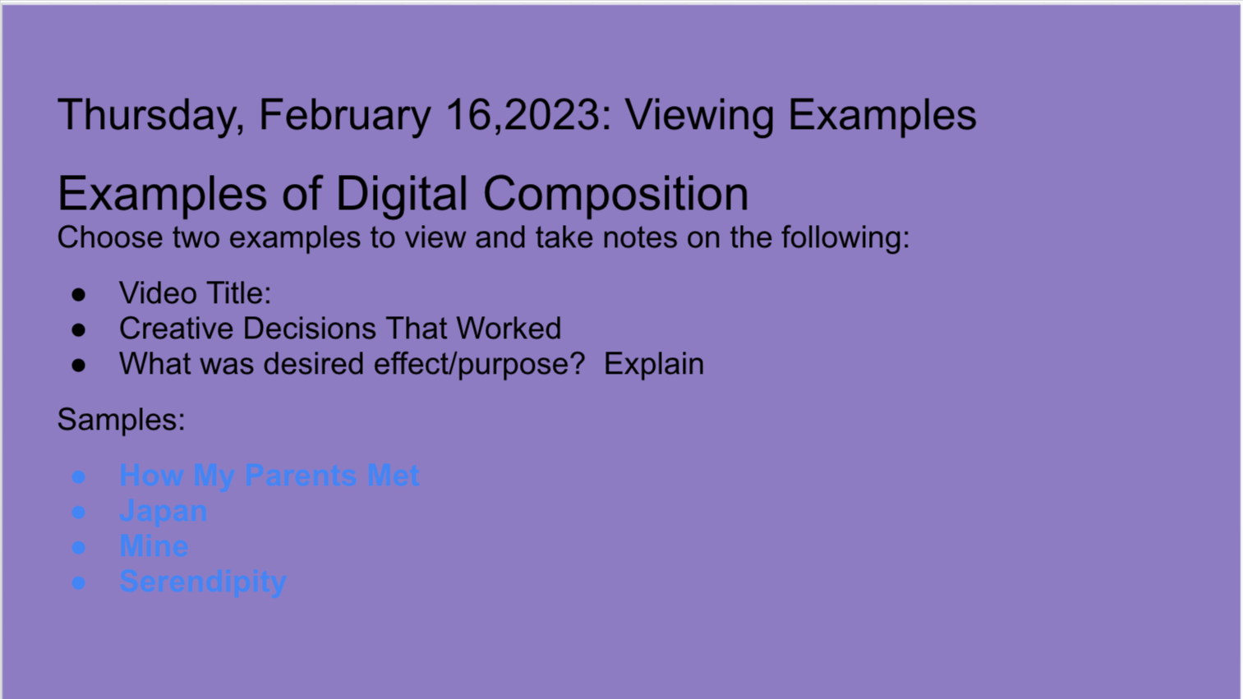
Getting Everyone Prepared!
Have students view samples
  Copy of Digital Composition Note Taking Guide
Have students share their thoughts on the videos
Move them toward “The Wedding Dress”
Samples:
How My Parents Met
Japan
Mine
Serendipity

Slide 12
Thursday, February 16,2023: Viewing Examples
Examples of Digital Composition
Choose two examples to view and take notes on the following:
Video Title:
Creative Decisions That Worked
What was desired effect/purpose? Explain
Samples:
How My Parents Met
Japan
Mine
Serendipity

Slide 13
“The Wedding Dress” Learning in Groups
Show them the slide with “ad.”
Give the directions:
  Link to Wedding Dress Directions
  Link to The Wedding Dress Planning Guide
  Link to Digital Composition Storyboard
Have the groups brainstorm:
  Look at the ad, what will the story be?
  Create the base storyline
  Then, grab your planning guide and start putting together your vision.
    What is the story?
    How will you break down the frames?
    What visual content?
    What musical content?
    Will there be a narrator?
  Before you even THINK about filming…see me! (this is built into their planning guide)

Slide 14
“The Wedding Dress” Samples
Sample Wedding Dress Videos
  Sample Video: English 2
  Sample Video AP Lit
Sample Wedding Dress Storyboards
  English 2 Summer School
Working in Groups:
  Have them assign roles and complete the planning guide
  Make sure that they check in with you prior to filming.
Viewing
  Watch them as a class!
  If you want, you can do a note-taking guide or reflection, a survey of which should “win” if you like competition!

Slide 15
Moving This to Texts (Literary and Expository)
Spring Book Club Directions
Samples of Planning Guides
  The Handmaid's Tale
  The Awakening
  Through the Looking Glass
Spring Book Clubs Samples
  Crime and Punishment
  A Doll House
  Brave New World
  The Handmaid's Tale
Done in groups (this time)
Viewing Party (good for “advertising” books for the next read!)

Slide 16
Moving This to Texts (Literary and Expository)
“The Yellow Wallpaper:- English 2
  Link to Essential Questions: English 2
    FYI: Essential Questions drove the semester; for a non collab class, I would ask students to connect 2 works in the composition
Link to The Yellow Wallpaper PDF
Link to Thematic Concepts
Link to Note-Taking Guide
“The Yellow Wallpaper” Digital Compositions
  Link to Yellow Wallpaper Digital Composition Directions
  Link to English 2 Digital Planning Guide Sample
  Link to English 2 Sample Video
  Link to English 2 Sample 2

Slide 17
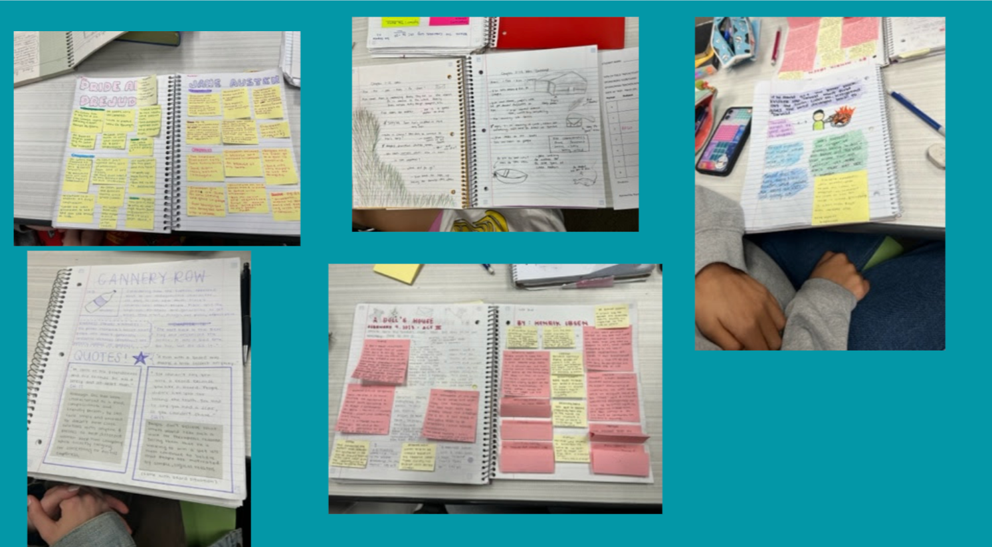
Transitioning to Writing!
It is not as big a leap as you may think!
Look at the steps that they have already completed:
  Read and marked a text
    Had additional discussions through the book club
    Added to their own notes
  Developed an Essential/Guiding Question
    To which they derived the answer
    Leading them to the theme, larger construct/idea
  Curated the evidence from the text
    Through the Digital Planning Guide
  Thought more critically ABOUT their argument as they:
    Chose visuals and music
    Organized them
    Wrote and Voiced the Scripts

Slide 18
Help the Kiddoes See That:
The Essential Question becomes the prompt.
  And they have had the voice in creating it.
The Answer to the Essential Question becomes the thesis statement.
The evidence that they found for the Digital Composition becomes their evidence for the writing.
  And they have a skeleton of their commentary in the script.
Their Storyboard/Planning Guide becomes the structure.
  It does not HAVE to be a five paragraph structure.

Slide 19
Review CCSS:
CCSS necessitates that students:
  Produce clear and coherent writing in which the development, organization, and style are appropriate to task, purpose, and audience.
  Develop and strengthen writing as needed by planning, revising, editing, rewriting, or trying a new approach, focusing on addressing what is most significant for a specific purpose and audience
  Use technology, including the Internet, to produce, publish, and update individual or shared writing products in response to ongoing feedback, including new arguments or information.
By the end of this process, they will have hit all of these and others!

Slide 20
Considerations:
Be ready to NOT be the expert in the room sometimes!
  They will know more about several of these things than we do.
  This is a good time to review the soft skills around communication.
Be ready to learn from them.
  This reinforces the idea that we are a community of learners.
  This gives them some voice and choice in the community.
Build in time for them to meet with you.
  In your planning doc, create checkpoints for them to meet up with you for a few minutes to make sure everything is moving along.
Enjoy the ride, they’ll teach you a thing or two!
  Make time to watch the videos .
  Make time for reflection. (not only what they learned, but what they may be interested in trying/reading next time)
Reflection: How might I be able to use something from today in my classroom?
Notes:
Toxic Masculinity Example
Ophelia as the most powerful character in Hamlet

Slide 21

Keep in Touch!
Email: trodriguezkam@fjuhsd.org, trodkam72@aol.com
Instagram: @trodriguezkam
Twitter: @LitTeacherTam

Slide 22
Works Cited
Jim Burke
What’s the Big Idea?
Kelly Gallagher and Penny Kittle
4 Essential Studies, Beliefs and Practices to Reclaim Student Agency
Catlin Tucker
Blended Learning
Jean M. Twenge
iGen: Why Today's Super-Connected Kids Are Growing Up Less Rebellious, More Tolerant, Less Happy--and Completely Unprepared for Adulthood--and What That Means for the Rest of Us

